Slide 1
Lecture 9
Lists & Dictionaries
Bryan Burlingame
27 March 2019

Slide 2
Announcements
Homework 6 due up front
Homework 7 due next after break
Read Chapter 12 & 13

Slide 3
Learning Objectives
Introduce Lists
Introduce Dictionaries
Understand the differences between the two data structures and when to use one over the other

Slide 4
Variables and Values
Recall: there are these things called values. Pieces of information (data) which have some characteristic (a data type), which can be operated on.
  Ex: 3.1415926 (a floating-point number or simply a float), 5 (an integer), “Hello mom” (a string)
Values can be stored in variables, named locations of memory used to store data.
  Variables are created using the assignment operator =
  Ex: salary = 100000

Slide 5
Bigger Data
Variables have a bit of a scale problem.
  Ex: How would we store all of the salaries for all of the workers of America?

Slide 6
Bigger Data
Variables have a bit of a scale problem.
  Ex: How would we store all of the salaries for all of the workers of America?
We need some mechanism to store large amounts of related data
  Python has a few, we’ll start with the simplest: lists

Slide 7
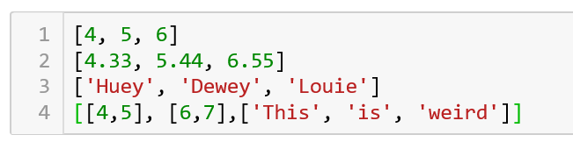
Lists
Lists are a container designed to hold a sequence of pieces of related data
  Each piece of data in a list is referred to as an element of the list or an item in a list
  Lists are intrinsic (built-in) to Python and a key feature of the language
  A list value is created by enclosing a set of data in square brackets, separating each piece of data by a comma
  Note: Lists a just considered a value; therefore, lists can contain lists
    The inner lists are said to be nested in the outer lists

Slide 8
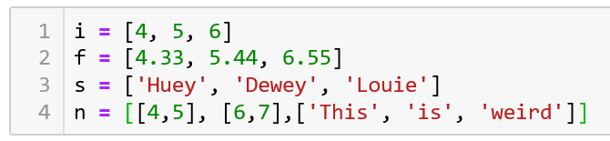
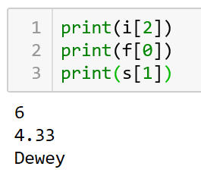
Lists and Variables
Predictably, lists can be stored in a variable using the assignment operator
Accessing an element of a list is done using the square bracket operator
The number in the square bracket is called
the index

Slide 9
Lists and Variables
Predictably, lists can be stored in a variable using the assignment operator
Accessing an element of a list is done using the square bracket operator
The number in the square bracket is called
the index
Note: indices start at 0, not 1, in Python
How would we print “weird” from n?

Slide 10
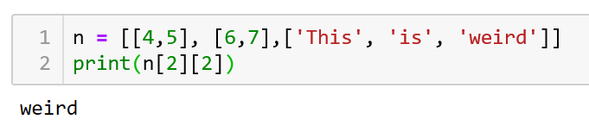
Lists and Variables
Predictably, lists can be stored in a variable using the assignment operator
Accessing an element of a list is done using the square bracket operator
The number in the square bracket is called
the index
Note: indices start at 0, not 1, in Python
How would we print “weird” from n?
Print the 3rd element of the 3rd element

Slide 11
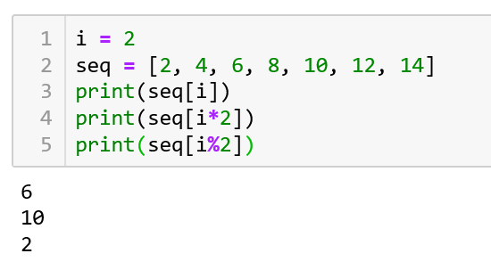
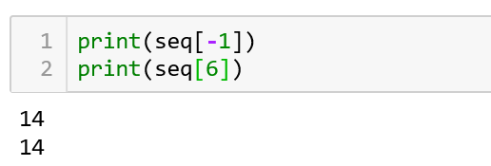
Indices
An index is simply an integer, so any expression which generates an integer can be used as an index
Negative indices return values counting from the end of the list

Slide 12
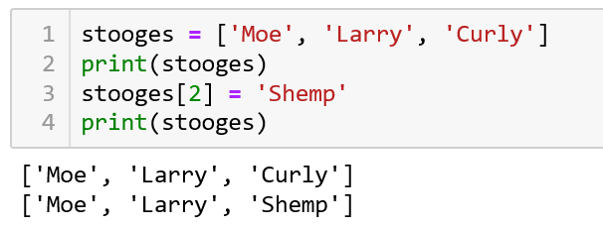
Mutability
Lists are mutable, the members can be changed
  Individual members are accessed using the same square bracket operator

Slide 13
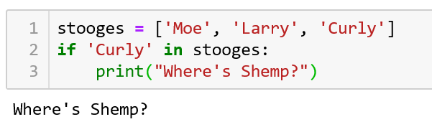
in Operator
The in operator reports true if a given value is an element of a list

Slide 14
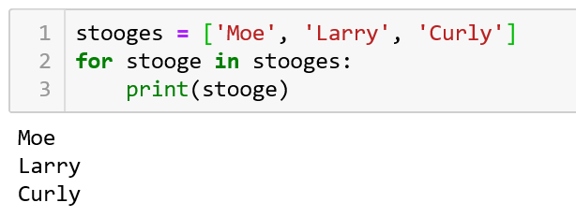
Traversing a list
Traversing a list, iterating over a list element by element and performing some set of operations on the element is most easily done with the in operator and a for loop
This construct is useful when the programmer needs to access, though not update each member of the list

Slide 15
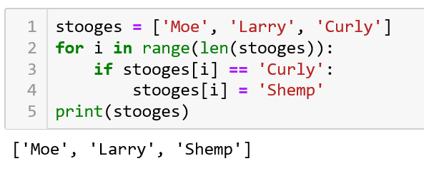
Traversing a list
To update, use the indices
Note: the len function returns the number of elements in a list

Slide 16
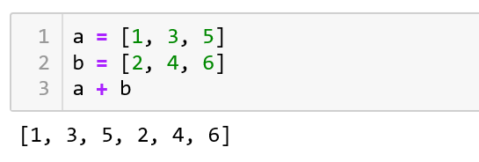
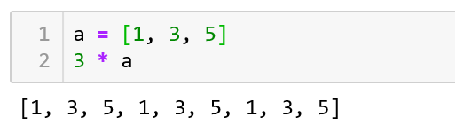
Other list Operators
+ addition concatenates two lists
* replicates a list n times

Slide 17
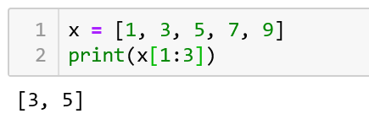
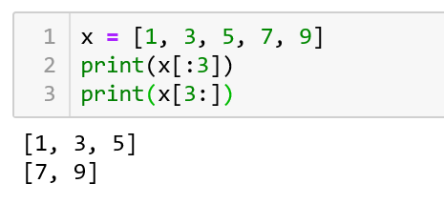
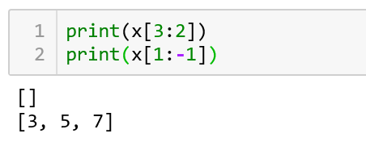
Slice Operator
It is possible to extract sublists using the slice operator, :
The slice operator returns a list comprised of the elements from some index to some other index in the form of list[x:y]
Note: the sublist is comprised of values from index x to index (y – 1)
If x is omitted, the beginning of the list is assumed. If y is omitted, the end of the list is assumed. If both are omitted, the whole list is returned
If y doesn’t come after x, an empty list is returned, though negative indices are allowed to find y

Slide 18
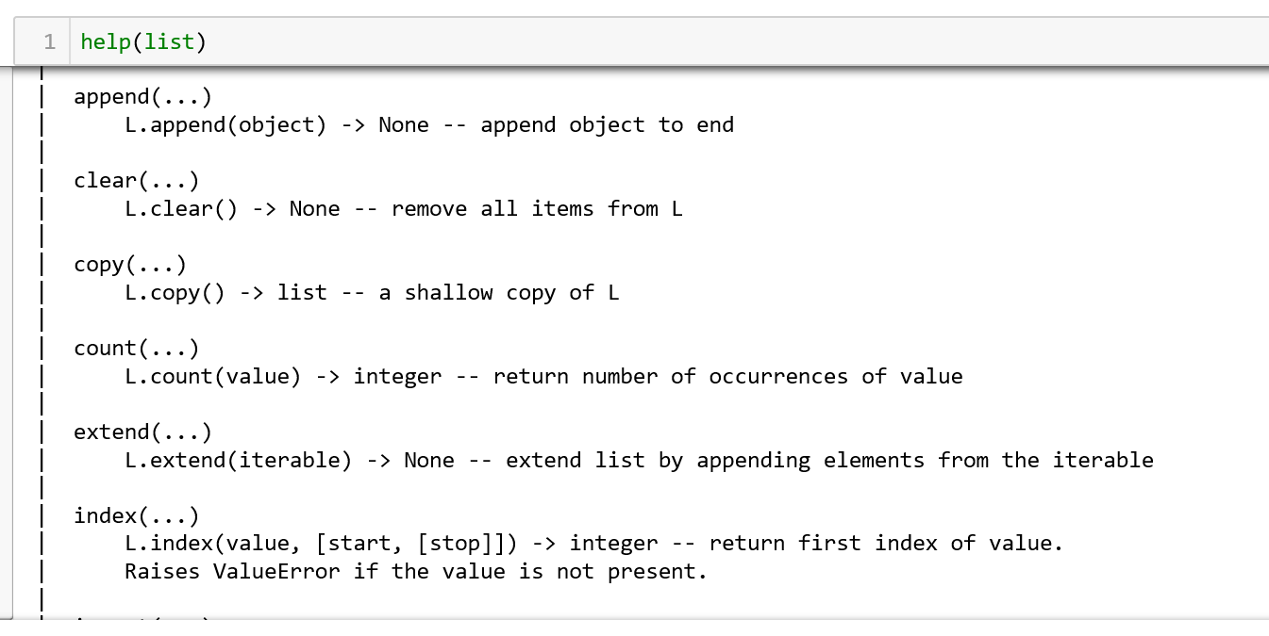
List methods
Methods are functions which operate on some item and are a part of that item. These items are called objects. Objects will be more formally introduced later in the course.
Methods are invoked using the . (dot) operator
Lists have a large number of methods

Slide 19
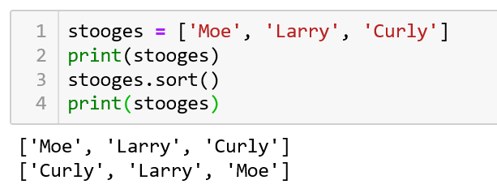
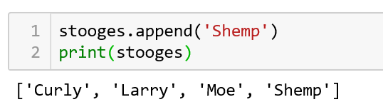
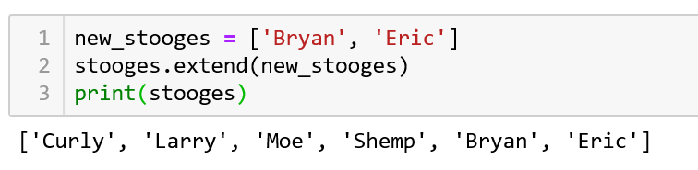
List methods
A few useful methods
  list.sort(), sorts the list
    Note: the list was sorted in place. list.sort returns none
  list.append(value) adds an element to the end of a list
  list.extend(list2) takes all the values of list2 and appends them to list

Slide 20
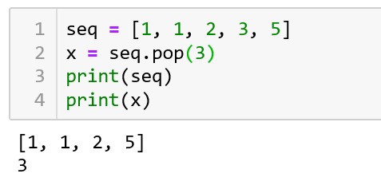
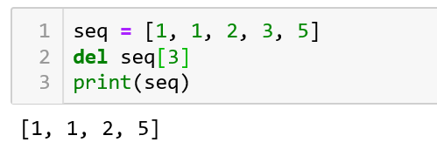
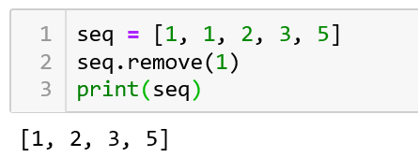
Removing elements
If the element to be removed location is known and the value is desired, use the pop method. pop without an index number, returns the last element of the list
If the value isn’t desired, use the del operation
If the location isn’t known, yet the value is, use the remove method.
  Note: it only removes the first instance of the value

Slide 21
Dictionaries
A dictionary is like a more general form of a list
  Dictionaries are comprised of a collection of indices (keys) and a collection of related values
  Dictionaries map a value to a key
    Referred to as a key-value pair
  We’ve seen this with lists
    Lists map an index (an integer) to a value
  Note that unlike strings and lists, dictionaries are not sequences. There is no implied ordering to the key-value pairs.

Slide 22
Dictionaries
A dictionary is like a more general form of a list
  Dictionaries are comprised of a collection of indices (keys) and a collection of related values
  Dictionaries map a value to a key
    Referred to as a key-value pair
  We’ve seen this with lists
    Lists map an index (an integer) to a value
  Note that unlike strings and lists, dictionaries are not sequences. There is no implied ordering to the key-value pairs.

Slide 23
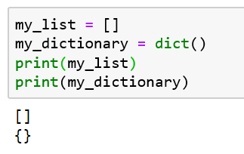
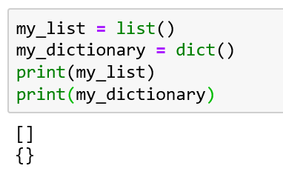
Declaring a Dictionary
Declaring a dictionary can be accomplished by invoking the dict() function
Notice the difference in the brackets
  Square brackets [] indicate a list
  Curly brackets {} indicate a dictionary

Slide 24
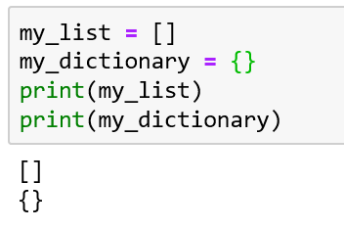
Declaring a Dictionary
Much like a list can be declared by initializing a variable to an empty list, a dictionary can be declared by initializing a variable to an empty dictionary

Slide 25
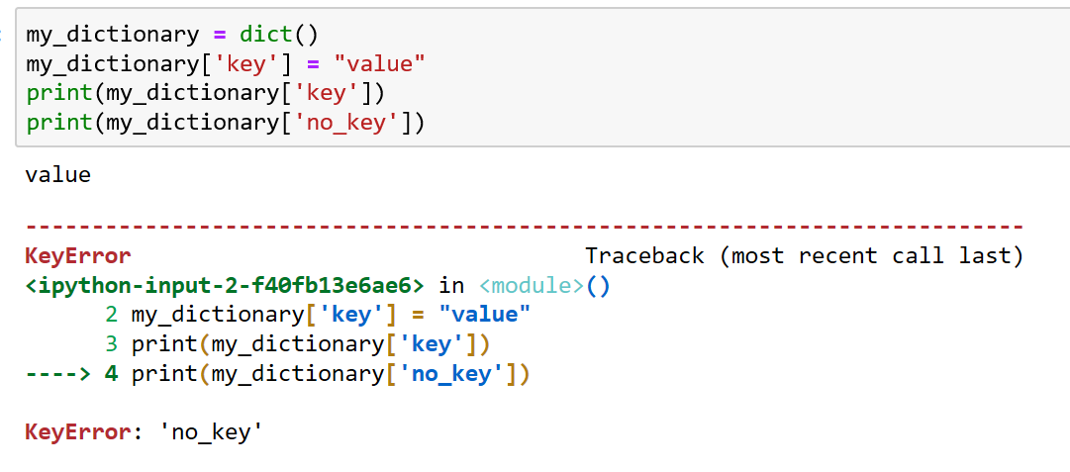
Assigning Members
To assign a member, use square brackets with an immutable value, such as a string, as the key
To access a member, use the same mechanism
If one attempts to access a key which does not exist, an exception occurs indicating a KeyError

Slide 26
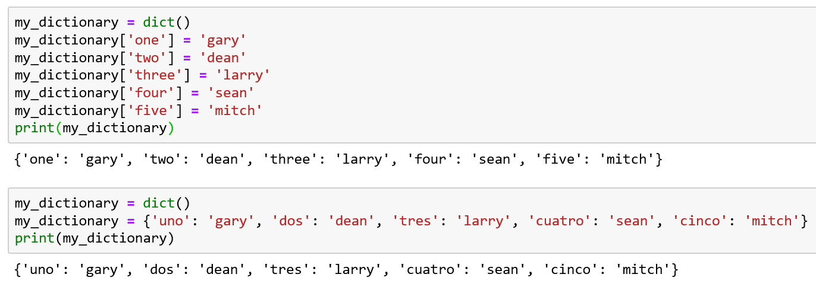
Short Form Assignment
Attempting to print a dictionary displays a set of key-value pairs within curly braces
That same format can be used to populate a dictionary
Note: though these examples seem to indicate the order of assignment is retained, dictionaries are not a sequence

Slide 27
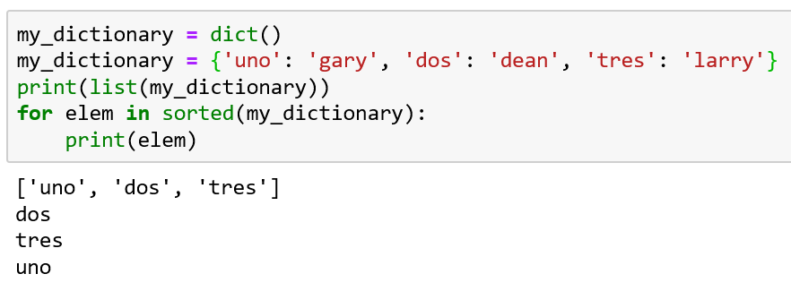
Obtaining a list of keys
When a dictionary is a parameter to the list function, the keys are returned in a list
The sorted function returns a list of sorted keys

Slide 28
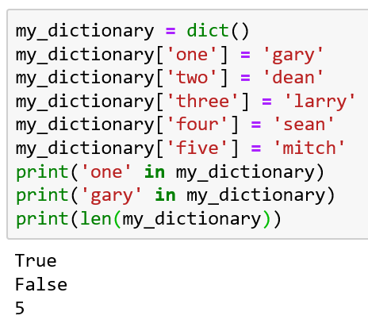
in operator and len
in checks to see if a key exists in the dictionary, not a value
len returns the number of key-value pairs

Slide 29
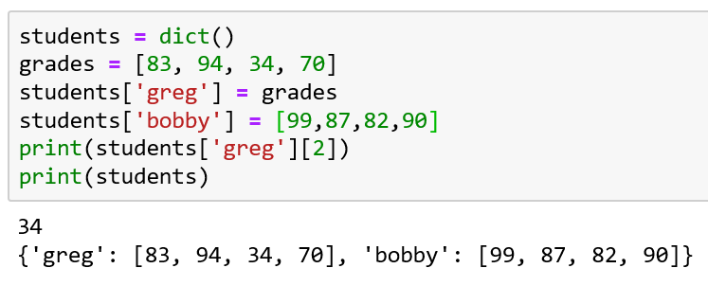
lists as values
lists can be values of a dictionary
Note the order of the keys/indices

Slide 30
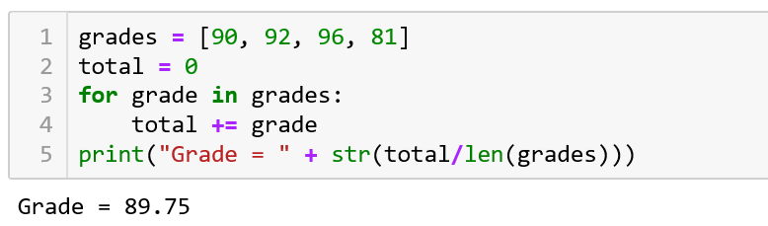
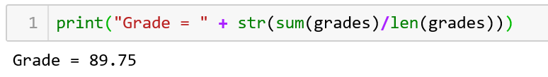
Reduction
Many times, it is useful to reduce a sequence to some value. This requires iterating over the sequence, performing some reducing operation, such as adding all the value in a sequence to some sum
Side note: this algorithm is called accumulation and the variable total is called the accumulator
  It is so common, that there is a built-in function to handle it: sum(list)

Slide 31
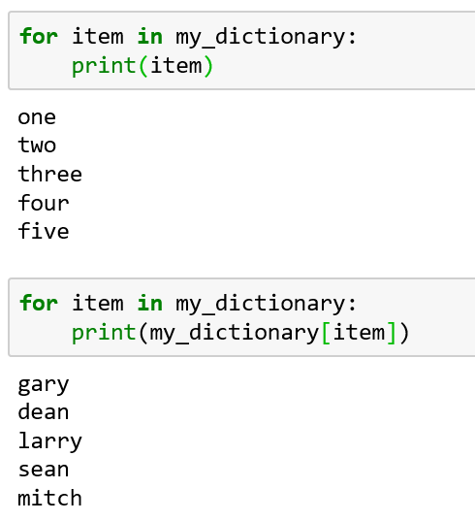
Dictionary Traversal
for loops over the keys of the dictionary
Those keys can be used to access the values
There is no automatic way to find a key given a value, though you could use a for loop and a comparison

Slide 32
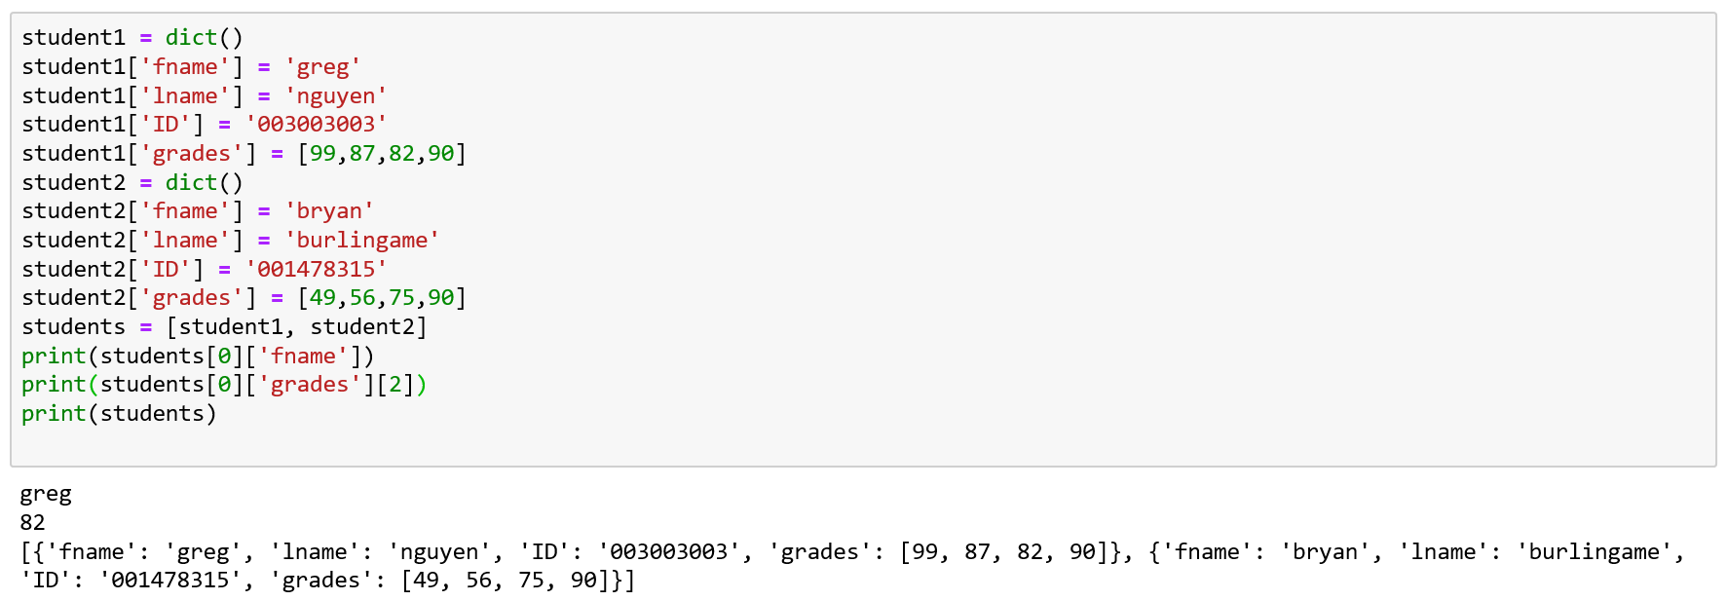
Lists of dictionaries of lists of…
Dictionaries can be values stored in lists which can be values stored in dictionaries…
This allows for storage of complex, related data
Sometimes these collections of data are called records
Note: I tend to use the plural for structures which refer to many things and the singular for structures which refer to one thing. This is a common style choice.

Slide 33
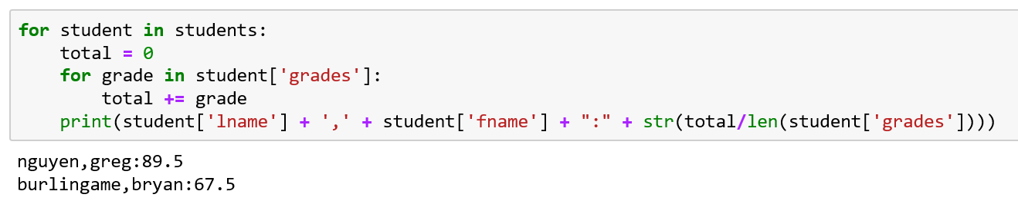
Looping through complex records
Nested for loops can iterate over these complex records
Given the previous students, let’s print their average grades

Slide 34
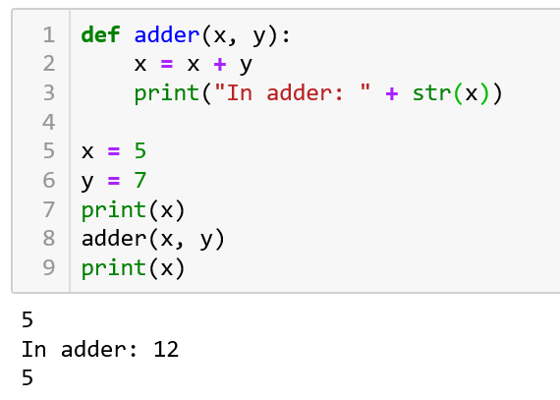
Functions and Containers
Containers can be passed to a function just like any value
Unlike scaler values, however, containers are passed by reference
  For simple scaler values, Python copies the value into the receiving variable
  Notice how x in __main__ doesn’t change

Slide 35
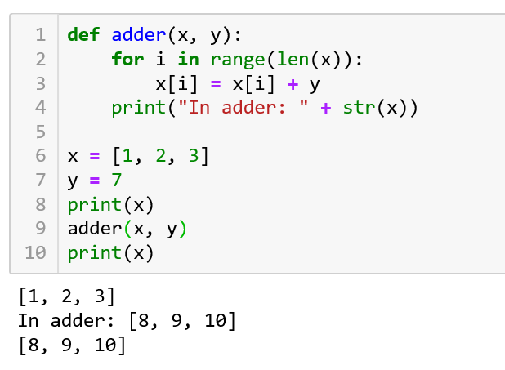
Functions and Containers
Instead of copying all of the values of x to the local x for adder, Python hands the function a reference
For now, this means changes to a container in a function affects the container from the calling function
  Notice how x in __main__ does change for a list
  We’ll cover this in more detail in the future

Slide 36
Resources
Downey, A. (2016) Think Python, Second Edition Sebastopol, CA: O’Reilly Media
(n.d.). 3.7.0 Documentation. 6. Expressions — Python 3.7.0 documentation. Retrieved September 11, 2018, from http://docs.python.org/3.7/reference/expressions.html

