Slide 1
Lecture 8: Arduino
20 March 2019

Slide 2
Announcements
Lab kits are available today and will be needed for labs this week
SNAFU with Homework 6. It will be due next week.
Eric Wertz will lead today’s discussion
  Introduction to the Arduino in Python
For next week, read chapter 10 & 11

Slide 3
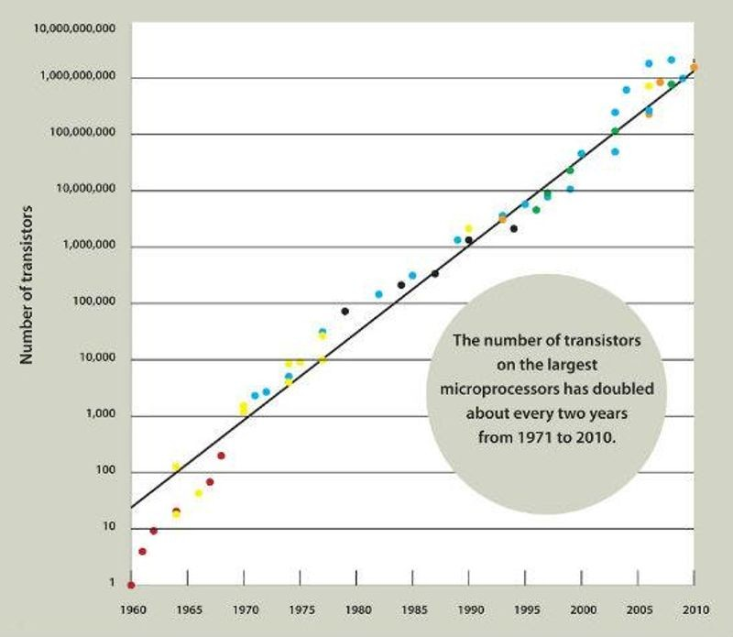
Embedded Systems
Recall:
  A computer takes input, performs some operations (the eponymous “compute”) and generates output
Modern general-purpose computers can take a wide range of input and generate a plethora of difference experiences
  This flexibility is expensive
  Uses general purpose operating
  systems
  Requires increasingly powerful
  hardware
Transistor count on largest microprocessors 1975-2010. From: Computer History Museum Revolution exhibit

Slide 4
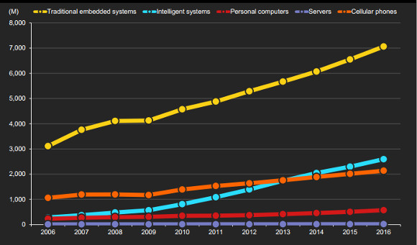
Embedded Systems
As microprocessors become cheaper
  Embedding microprocessors as a control mechanism has become more common
  Embedded systems now
  dominate the market
  Modern embedded systems have
  integrated many peripherals and
  the CPU into one chip called a
  Microcontroller
Embedded Systems vs Other Silicon Market Segments
The Register

Slide 5
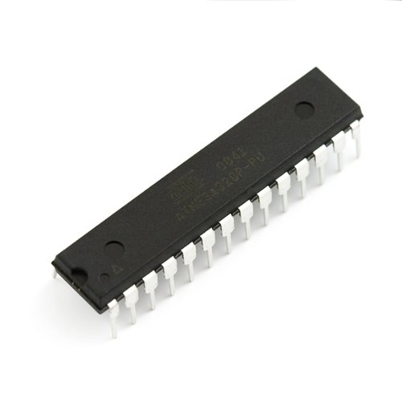
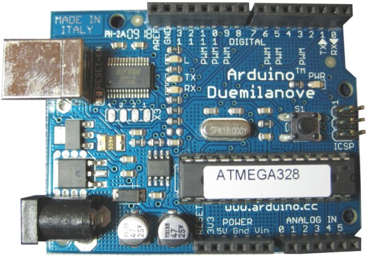
What is a Microcontroller?
A small computer usually implemented on a single integrated circuit (IC) that contains a central processing unit (CPU), some memory, and peripheral devices such as counter/timers, analog-to-digital converters, serial communication hardware, etc.
ATmega328
the ‘brain’ of the Arduino
http://www.amazon.com/AVR-Pin-20MHz-32K-ATMega328/dp/B004G5AVS6

Slide 6
Where are Microcontrollers Used?
Everywhere!
  Car
  Phone
  Toothbrush
  Microwave oven
  Copier
  Television
  PC keyboard
  Xbox Controllers
  Appliances
http://ecomodder.com/wiki/index.php/MPGuino

Slide 7
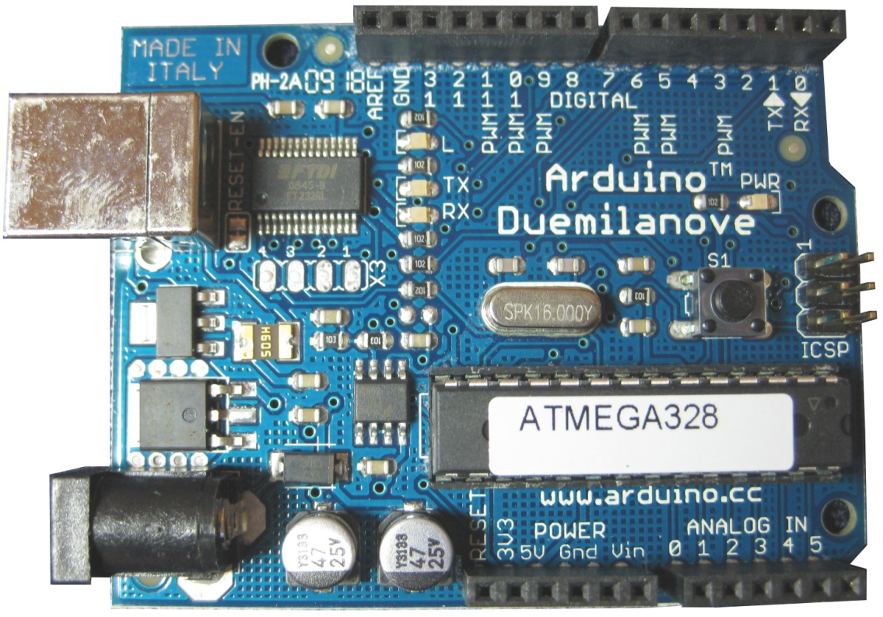
The Arduino Platform
About 10 years old and more than 1M units sold
Open Source hardware and software
  Open Source: the source code to build the software and the designs to build the hardware are publicly available
  Anyone who is willing to follow the license may build on this platform
  There are many clones
    Since the designs are publicly available, these clones tend to be of high quality and perfectly compatible
  Arduino itself is a brand that encompasses the entire system
    The Arduino hardware itself, including the shape of the dev board
    The programming interface (API)
    The Arduino integrated programming
    environment (IDE)
    http://Arduino.cc

Slide 8
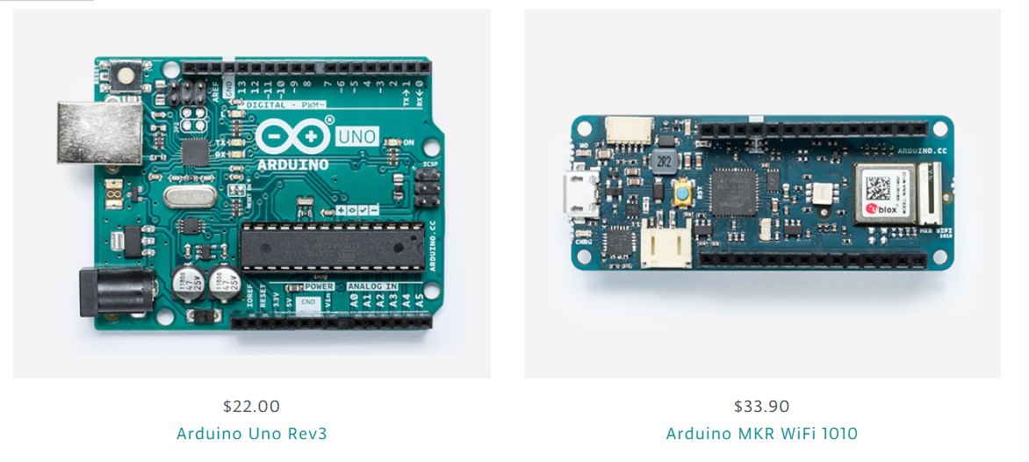
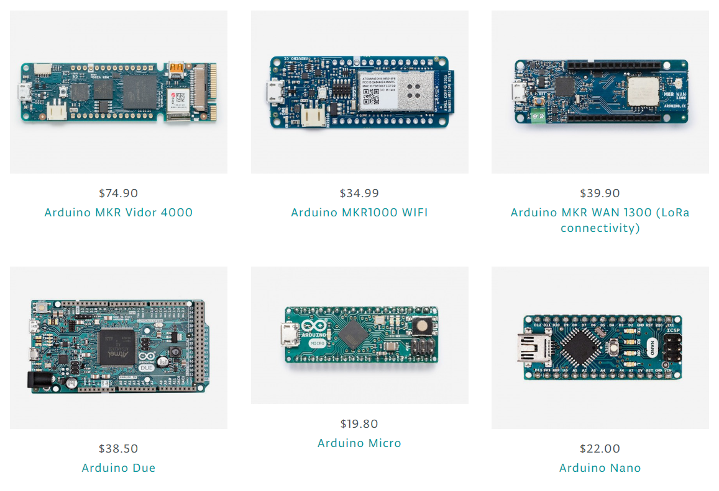
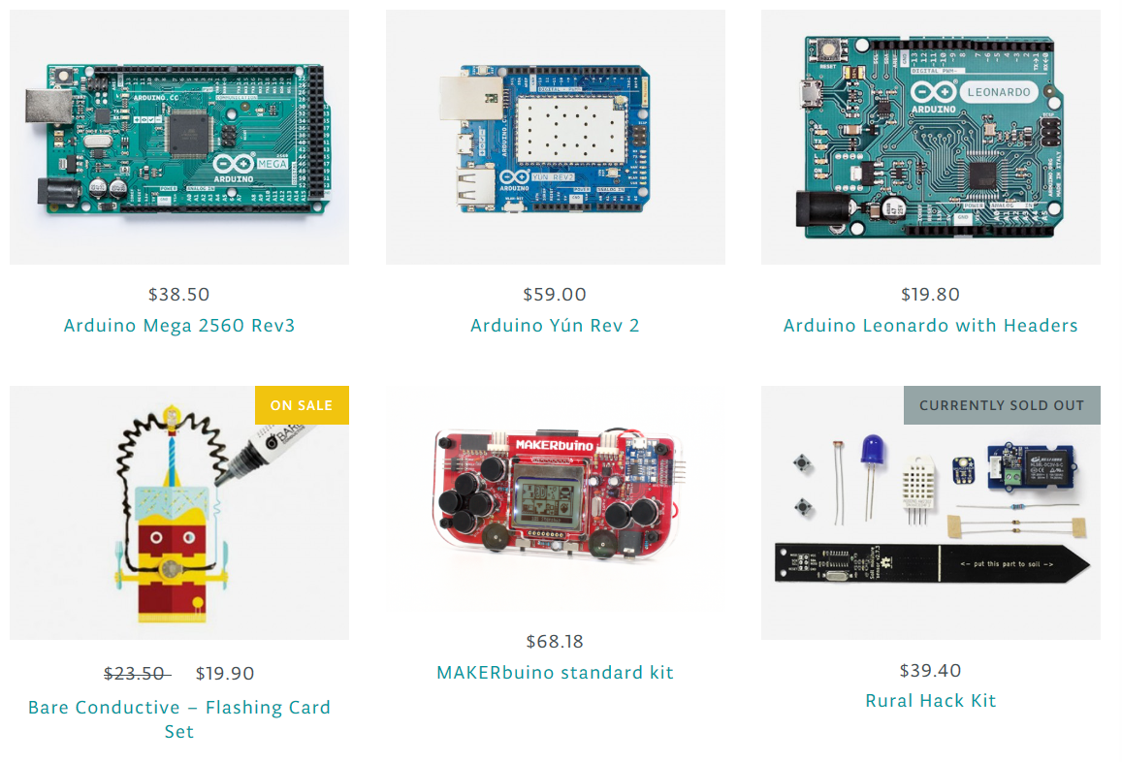
The Arduino Platform
Arduino is a family
  The Arduino UNO is the most popular
  There are many form factors and with differing capabilities
  The UNO standardization of the UNO platform allows for many hardware accessories (called shields) to exist
There is competition
  Raspberry Pi
  Micro:bit
  MicroPython
  Feather/CircuitPython
  Azure Sphere

Slide 9
The Arduino Platform
Rx + Tx
LEDs
Pin 13 LED
Digital Pins
Atmel ATmega328 microcontroller
14 digital I/O pins
  6 with PWM
6 analog I/O pins
32 kB (-2 kB)
Flash memory
2 kB RAM
1 kB EEPROM
16 MHz clock
$22 - $30 built
  $13 ‘breadboardable’
Power
LED
USB
jack
Reset
Button
FTDI
USB chip
Voltage
regulator
ICSP
Header
Microcontroller
power
jack
Pwr/GND Pins
Analog Pins
http://arduino.cc/

Slide 10
Our implementation
Usually, the Arduino is programmed in C/C++
Obviously, we’re exploring Python
  Easier to learn
  Allows a focus on programming skills over detail
  Not perfect
    Requires more memory than the Uno has
    We’ll run tethered to a PC, allowing the PC to parse the Python
    Allows us to integrate the PC experience with an embedded system

Slide 11
PyMata
PyMata is a library we’ll use with Jupyter Notebook to facilitate
  Uses the Firmata protocol
Supports much of the Arduino functionality
  General Purpose Input/Output (GPIO)
    Boolean signaling (T/F, On/Off, 5V/Ground)
    Called Digital in the hardware world
    Allows for simple on/off actuation or detection
      Think turning a light on and off or detecting whether a switch has been pressed or not
  Analog
    Allows for a range of values
    Input for sensors and output for actuators
      Think reading a temperature or playing music (i.e. not just T/F)

Slide 12
Spartronics Experimenter Digital Pin Assignments
13 | 12 | 11 | 10 | 9 | 8 | 7 | 6 | 5 | 4 | 3 | 2 | 1 | 0
SCK | MISO | MOSI | SS | OC1 | ICP | AIN1 | AIN0 | T1 | T0 | INT1 | INT0 | TXD | RXD
LED |  |  |  |  |  |  |  |  |  |  |  | LED | LED
 |  | pwm | pwm | pwm |  |  | pwm | pwm |  | pwm
 |  | LED0 |  | LED1 |  |  | LED2 |  |  | LED3
 |  |  |  | green |  |  | blue |  |  | red
 |  |  |  |  |  |  |  | piezo
 |  |  | servo
 | SW0 |  |  |  | SW1 | SW2 |  |  | SW3
Notes:
Piezo rectangle is hyperlinked to an image of the actual Experimenter board. The piezo speaker is hyperlinked back to this slide.

Slide 13
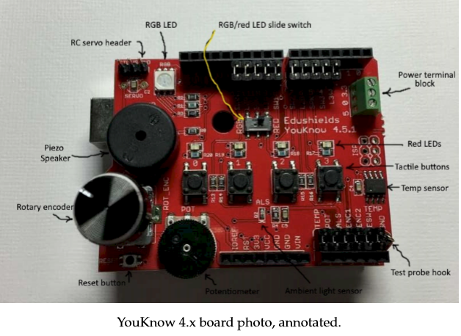
Spartronics Experimenter Analog Pin Assignments
7 | 6 | 5 | 4 | 3 | 2 | 1 | 0
 |  |  |  |  | photocell | POT | temp sensor
Notes:
The rectangle around cells for pins 2, 1, 0 are hyperlinked to an image of the actual Experimenter board. Each respective element is hyperlinked back to this slide.

Slide 14
PyMata
Though Firmata provides a low-level interface, we’ll use something a bit more civilized
PyMata provides an intuitive object-based interface to the hardware
  Button: ispressed()
  LED (Light emitting diode): led.on(), led.off()
  LEDPWM: led.on(), led.off(), led.fraction()
  Pot (Potentiometer): pot.fraction()
  Servo: servo.write(degrees)
  Speaker: spkr.play(freq)
https://github.com/MrYsLab/pymata-aio/wiki

