Slide 1
Lecture 7
Strings
Bryan Burlingame
13 March 2019

Slide 2
Announcements
Homework 5 due up front
Begin Arduino next week
Read Chapters 9, 10, Automate the Boring Stuff Chapter 7
Homework 6 due next week

Slide 3
Learning Objectives
Introduce and discuss strings & sequences

Slide 4
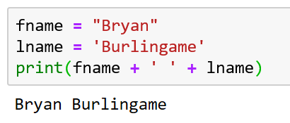
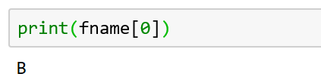
Strings
A string is a sequence of values, specifically a sequence of characters
Basic string initialization uses quotes, either single ‘’ or double “”
Individual letters can be accessed via the [] operator and some index
Remember: the index starts at zero

Slide 5
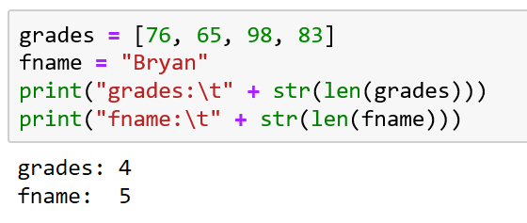
len
len() returns the number of characters of the string

Slide 6
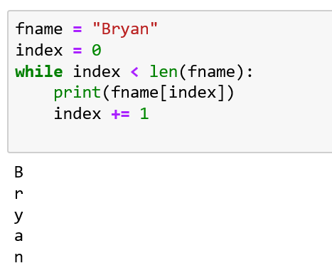
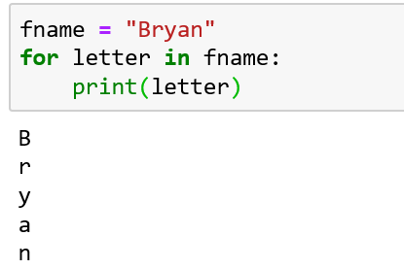
Traversal
Traversing a collection is the process of working on the collection element by element
Either a for loop or a while loop can be used to traverse a string
The for loops is more natural

Slide 7
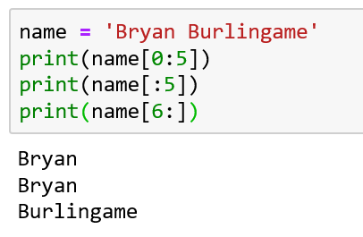
Slicing a string
The slice operator [:] can extract substrings from a string
For string[a:b] return the characters from a to (b-1)
  If a is omitted, assume 0
  If b is omitted, assume the end of the string
  If both are omitted, return a copy of the string

Slide 8
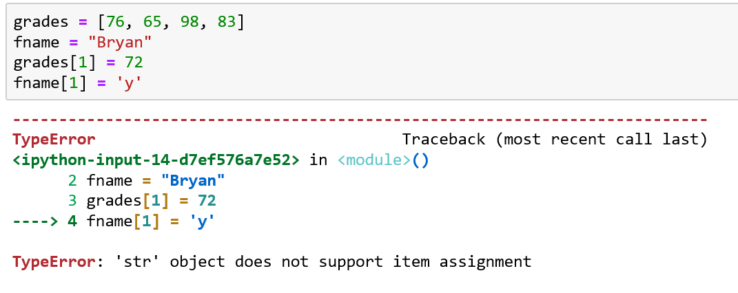
Mutability
Strings are immutable. The characters of a string cannot be changed
  The “grades[1] = 72” line passes, the error is on the next line

Slide 9
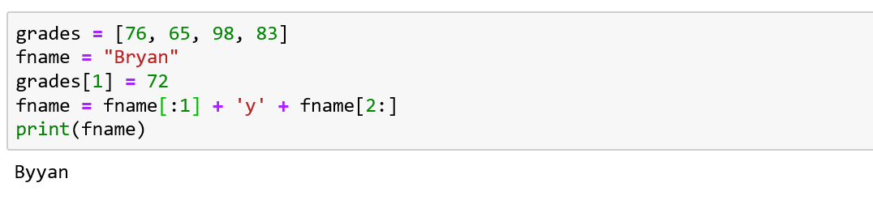
Mutability
Strings are immutable. The characters of a string cannot be changed
  The “grades[1] = 72” line passes, the error is on the next line
  Use slices and concatenation, instead

Slide 10
Mutability
Strings are immutable. The characters of a string cannot be changed
  The “grades[1] = 72” line passes, the error is on the next line
  Use slices and concatenation, instead
There are mutable collections, we’ll discuss some of them soon.

Slide 11
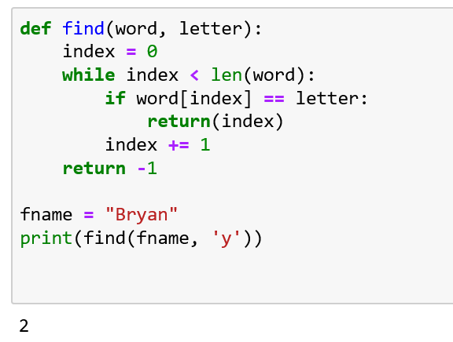
Search
Search is the process of traversing a sequence, evaluating each member of that sequence for some value, and returning when the value is found
From the text:

Slide 12
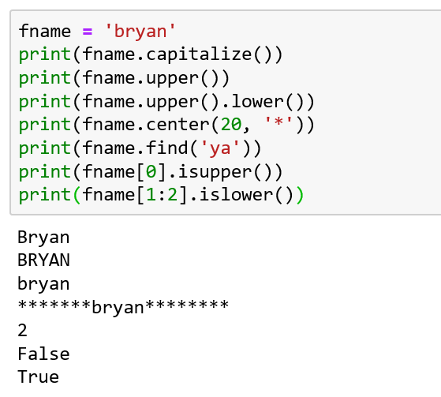
Strings Methods
Strings have many methods
Since strings are immutable, many methods return a string
Note: slices of a string are considered strings as well
  https://docs.python.org/3/library/stdtypes.html#string-methods

Slide 13
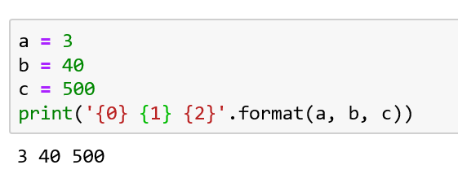
String Formatting
Strings are generally intended to be consumed by people. Attractive and consistent formatting makes this easier
Python has a mini-language just for formatting
  Takes the form “Format Spec”.format(thing_to_be_formatted)
  Each element of the format list is matched in order with a replacement field {#}
  {0} == a, {1} == b, {2} == c, where the format is specified within the {} and between the {} (note the spaces in the format string and the output)
https://docs.python.org/3/library/string.html#formatstrings

Slide 14
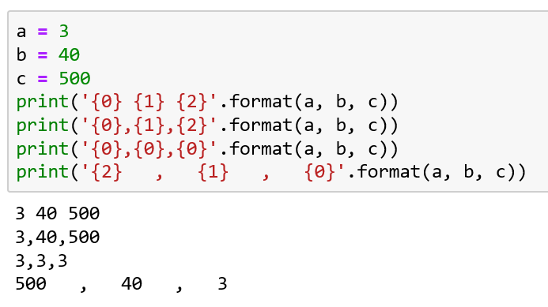
String Formatting - Examples
Note how the values follow the replacement field and the inter-replacement field characters are added

Slide 15
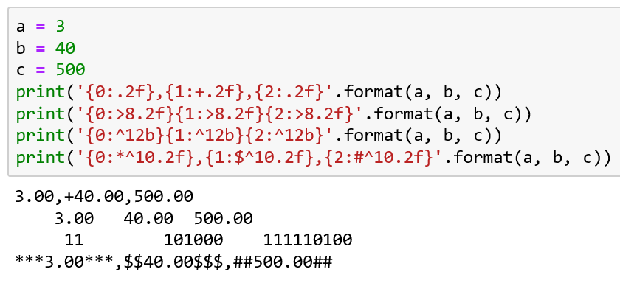
String Formatting - Examples
Formatting of the values are controlled in the replacement field
  {#:format_spec}
  Ex: {0:.2f} – format the 0th value, display as a float with 2 decimal places

Slide 16
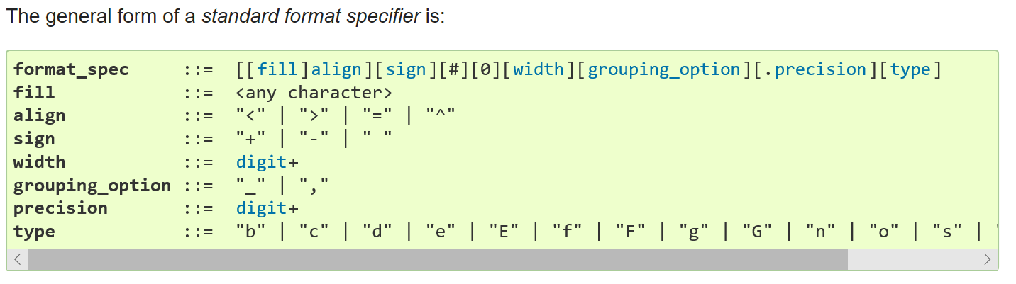
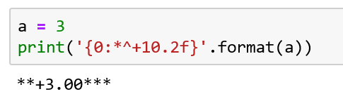
String Formatting - General
Each of the options on the format_spec line can be included
Print a minimally 10 character wide field, field. Center the value. Include the + sign, show as a 2 decimal point float. Fill in any white space with an asterisk *
https://docs.python.org/3/library/string.html#formatstrings

Slide 17
String Formatting - General
Each of the options on the format_spec line can be included
Print a minimally 10 character wide field, field. Center the value. Include the + sign, show as a 2 decimal point float. Fill in any white space with an asterisk *
https://docs.python.org/3/library/string.html#formatstrings

Slide 18
String Formatting - General
All the values in the format_spec are optional
Go to the docs to understand what each value controls
Note that this is a very succinct mini-language
https://docs.python.org/3/library/string.html#formatstrings

Slide 19
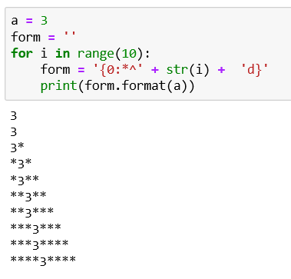
String Formatting - General
The format_spec is simply a string; therefore, it can be transformable

Slide 20
Resources
Downey, A. (2016) Think Python, Second Edition Sebastopol, CA: O’Reilly Media
(n.d.). 3.7.0 Documentation. String Methods — Python 3.7.0 documentation. Retrieved October 16, 2018, from https://docs.python.org/3/library/stdtypes.html#string-methods

