Slide 1
Lecture 6
Iteration
Bryan Burlingame
6 March 2019

Slide 2
Announcements
Homework 4 due up front
Read Chapter 8
Homework 5 due next week

Slide 3
Learning Objectives
Discuss iteration
Connect iteration to summation

Slide 4
Review
So far, we have discussed
  Values - numeric and string
  Operators – a manner to calculate some result from a set of values
  Variables – the ability to store a value for future use
    Recall: we can reassign a variable to a different value throughout our program (this will come in useful later, today)
  Functions – segments of code with defined interfaces we can use to partition the process of programming
  Recursive functions – functions which call themselves, creating repetition
  Decision making – choosing which segment of code to run, based on some boundary criterion
This defines a “Turing complete language” with these operations, we can direct a computer to do anything a computer can do

Slide 5
Review
So far, we have discussed
  Values - numeric and string
  Operators – a manner to calculate some result from a set of values
  Variables – the ability to store a value for future use
    Recall: we can reassign a variable to a different value throughout our program (this will come in useful later, today)
  Functions – segments of code with defined interfaces we can use to partition the process of programming
  Recursive functions – functions which call themselves, creating repetition
  Decision making – choosing which segment of code to run, based on some boundary criterion
This defines a “Turing complete language” with these operations, we can direct a computer to do anything a computer can do

Slide 6
Iteration (Repetition)
Iteration: repetition of a computational process
We already have recursion, why do we want other ways of repeating code segments? What’s the limitation of recursion?

Slide 7
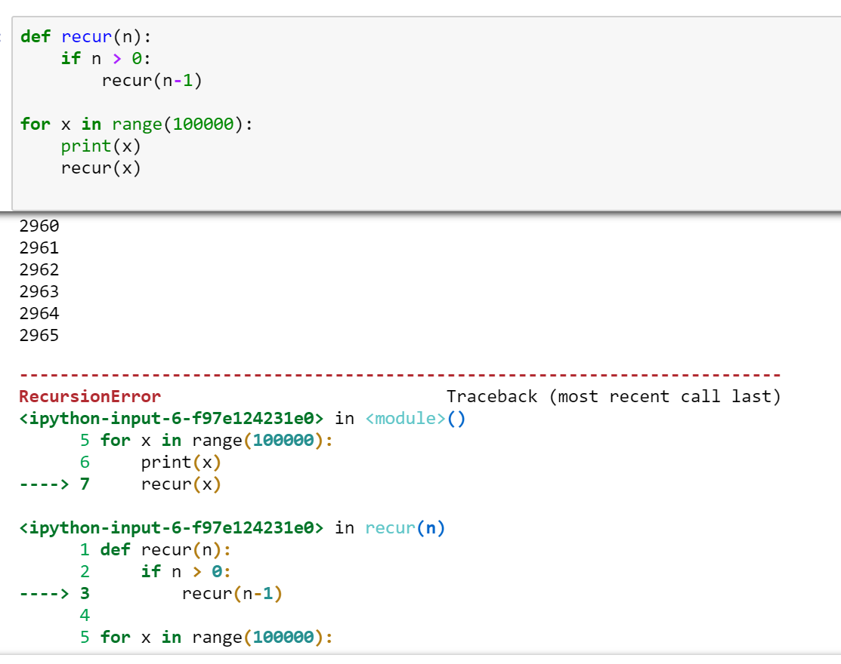
Iteration (Repetition)
Iteration: repetition of a computational process
We already have recursion, why do we want other ways of repeating code segments? What’s the limitation of recursion?
  Recursion is expensive – requires many extra compute cycles and requires the computer to track all the waiting function calls
  On my install of Jupyter, the stack blows up on the 2,966th recursion attempt

Slide 8
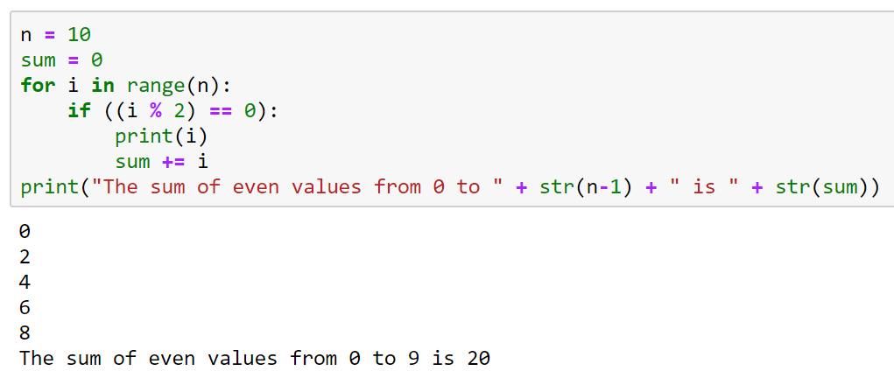
Simple Repetition
We can repeat a code segment using a simple repetition recipe based on the for keyword
for iterates over the members of a collection of items
  i.e. a for loop repeats a segment of code one time for each value in a set of values, changing the value of an iterating variable on each loop
  The variable which changes values is called an iterator
We will revisit for many times

Slide 9
Simple Repetition
We can repeat a code segment using a simple repetition recipe based on the for keyword
for iterates over the members of a collection of items
  i.e. a for loop repeats a segment of code one time for each value in a set of values, changing the value of an iterating variable on each loop
  The variable which changes values is called an iterator
We will revisit for many times
i is the iterator
range creates a list of integers from 0 to (n-1)

Slide 10
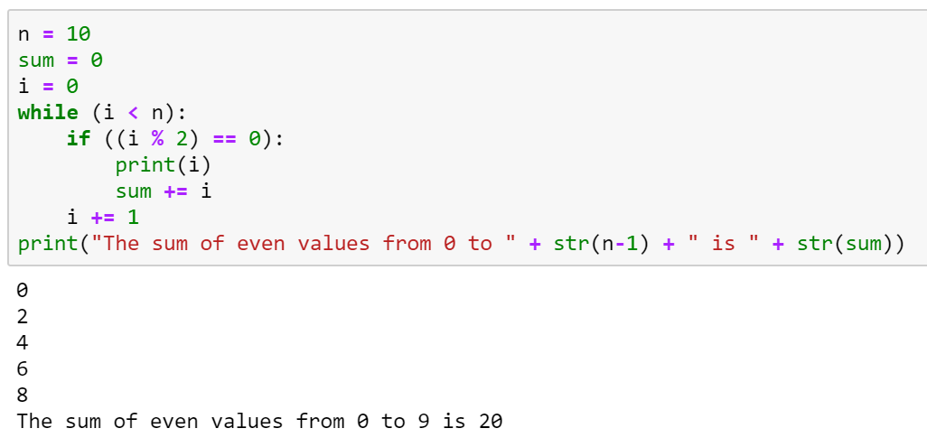
Iteration
for specifically iterates over a collection of items, what if we want to repeat on some other condition?
while keyword allows for repetition based on an arbitrary condition
Looks like if, but repeats instead of only running once
What would happen if the i += 1 line didn’t exist?

Slide 11
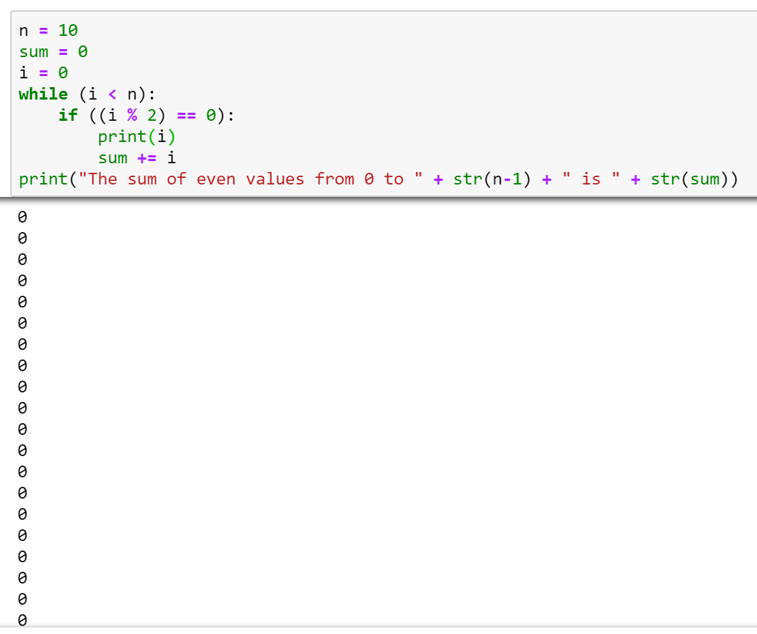
Iteration
for specifically iterates over a collection of items, what if we want to repeat on some other condition?
while keyword allows for repetition based on an arbitrary condition
Looks like if, but repeats instead of only running once
What would happen if the i += 1 line didn’t exist?
  The boundary condition is never violated, creating an infinite loop

Slide 12
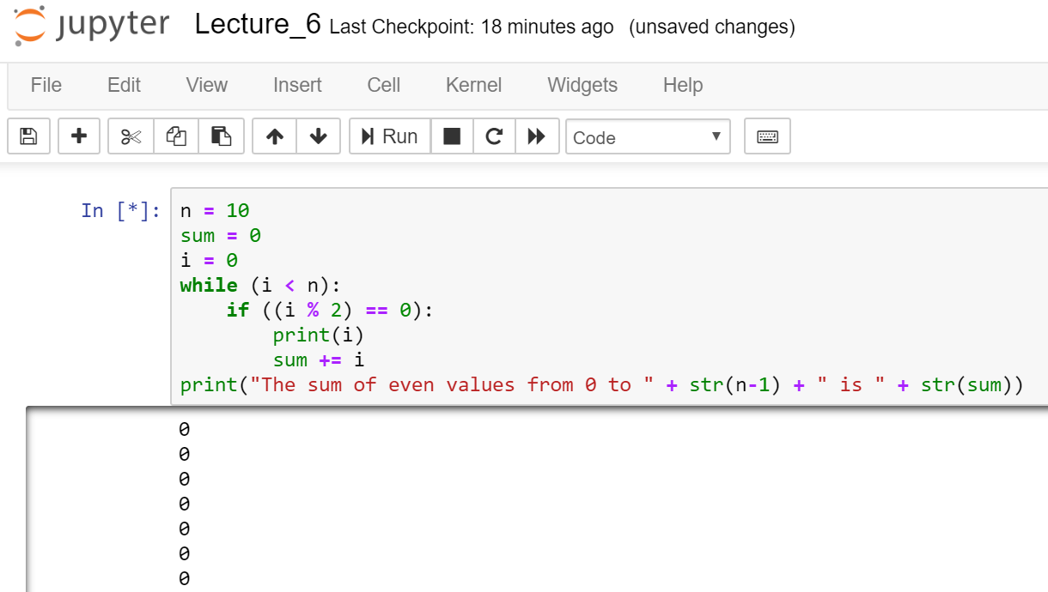
Jupyter Notebook
The * indicates this cell is still running

Slide 13
Jupyter Notebook
Execution can be terminated with the Stop button

Slide 14
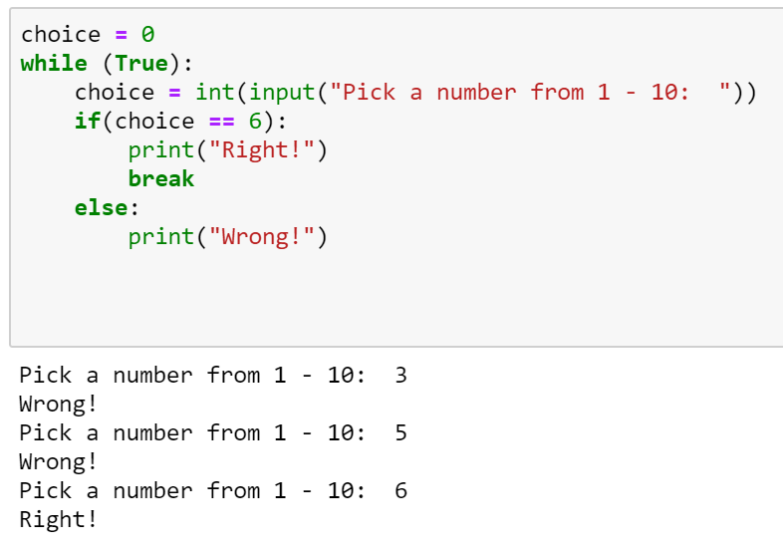
Break
It is possible to stop a loop partway through, using the break instruction
Without the break, this would be an infinite loop

Slide 15
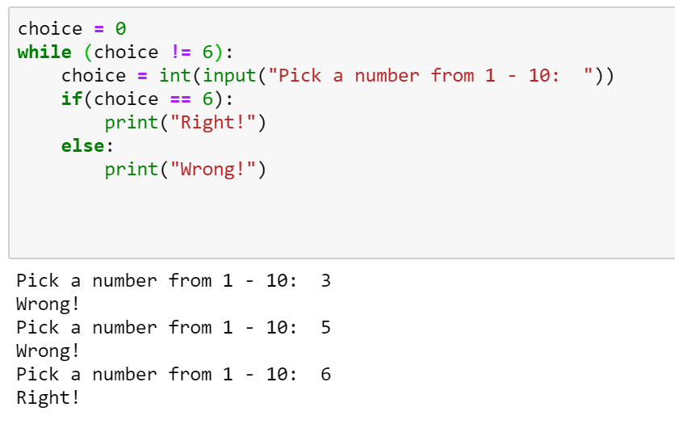
Break
It is possible to stop a loop partway through, using the break instruction
Without the break, this would be an infinite loop
Here, I disagree with the esteemed Mr. Downey
  Break should be rare, not common
  We already have ways to invert logic using negation (!, not)
  By placing the boundary in the middle of the loop, we make debugging an error harder

Slide 16
Series Approximations
For many mathematical phenomena, we can approximate the value using a series
  You may have seen the Taylor series in Calculus I
This is one of the fundamental uses of a computer

Slide 17
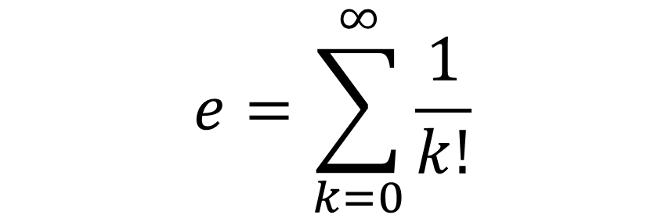
Series Approximations
$$e=\sum_{k=0}^{∞}{\frac{1}{k!}}$$
For many mathematical phenomena, we can approximate the value using a series
  You may have seen the Taylor series in Calculus I
This is one of the fundamental uses of a computer
Let’s look at Euler’s number
Algorithm:
e = 0
k = 0
add 1 / k! to e
add 1 to k
repeat previous two line

Slide 18
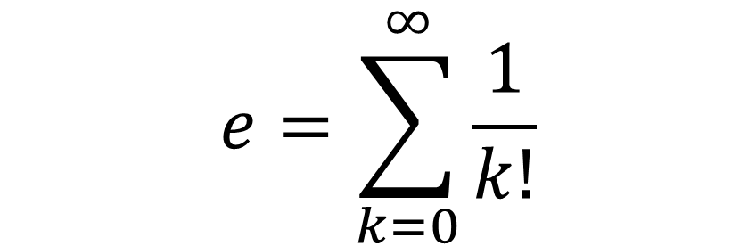
Series Approximations
$$e=\sum_{k=0}^{∞}{\frac{1}{k!}}$$
For many mathematical phenomena, we can approximate the value using a series
  You may have seen the Taylor series in Calculus I
This is one of the fundamental uses of a computer
Let’s look at Euler’s number
Computers are finite; we must bound this algorithm
  Once we have the precision we want, stop
  The change in precision is frequently called epsilon
Algorithm:
e = 0
k = 0
previous_e = 1
epsilon = 1
while epsilon > 1x10⁻⁷
  add 1 / k! to e
  epsilon = e – previous_e
  previous_e = e
  add 1 to k

Slide 19
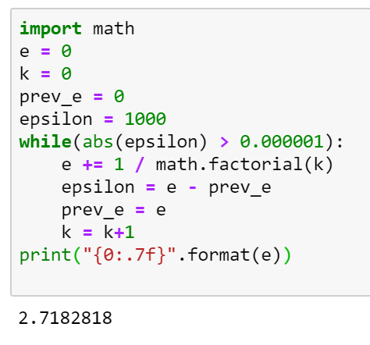
Series Approximations
$$e=\sum_{k=0}^{∞}{\frac{1}{k!}}$$
For many mathematical phenomena, we can approximate the value using a series
  You may have seen the Taylor series in Calculus I
This is one of the fundamental uses of a computer
Let’s look at Euler’s number
Computers are finite; we must bound this algorithm
  Once we have the precision we want, stop
  The change in precision is frequently called epsilon
Algorithm:
e = 0
k = 0
previous_e = 1
epsilon = 1
while epsilon > 1x10⁻⁷
  add 1 / k! to e
  epsilon = e – previous_e
  previous_e = e
  add 1 to k

Slide 20
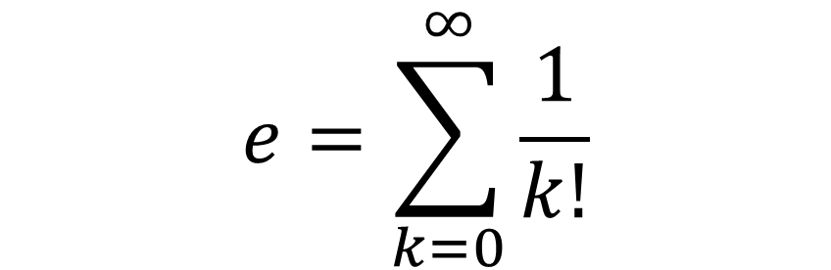
Stitching it all together
$$e=\sum_{k=0}^{∞}{\frac{1}{k!}}$$

Slide 21
Resources
Downey, A. (2016) Think Python, Second Edition Sebastopol, CA: O’Reilly Media
(n.d.). 3.7.0 Documentation. 6. Expressions — Python 3.7.0 documentation. Retrieved September 11, 2018, from http://docs.python.org/3.7/reference/expressions.html

