Slide 1
Lecture 15
Teamwork
Bryan Burlingame
5 December 2018

Slide 2
Announcements
Final exam, groups of 3. Schedule time on the 16th/17th.
  Grading will include
    Correctness of the solution
    Quality of the code generated to solve the problem
      Clarity of the presented algorithm
      Proper partitioning of the problem into functions
      Logical mechanisms to store the data points (list vs dictionaries vs tuples vs objects)
    Quality of the lab report

Slide 3
Academic Honesty
This should not need to be said, but the work should be your own.
Do not work with another team.
I will be seeing your code in rapid succession, it is likely that I’ll notice if your solution is particularly like another teams.
Similarly, the code you’ll get from going to an online source will not look like code from this course. If your code is particularly foreign, expect hard questioning.
Cite all sources
Pull your weight. Your teammates will have an opportunity to provide feedback. The feedback will be grade impacting.

Slide 4
Final Project
Create a digital temperature gauge and record
Grab the current temperature from a website of your choosing for San Jose, CA
Read the temperature sensor (A0) from the Arduino
  Assume the first read of the temperature sensor equates to the current temperature in San Jose, CA
Every 15 seconds, read the temperature sensor again.
  Don’t just sleep for 15 seconds, account for the processing time for all further instructions.
  Update the RGB LED based on temperature
  Update a file with current temperature
  Update a live graph with current temperature

Slide 5
Final Project - LED
Update the RGB LED
  If the temp is more than 10% from initial, turn the RGB LED Red. Set intensity to 10% at first, increasing to 100% at +20%
  If the temp is less than 10% from initial, turn the RGB LED Blue. Set intensity to 10% at first, increasing to 100% at -20%
  If the temp is within 10%, turn the RGB LED Green with the intensity at 100% when equal to initial temp and decreasing to 0% at +/- 10%
  Write the temperature to a file with a time stamp
  Update a plot of the current temperature over time

Slide 6
Final Project - Log
Update a log file of the temperature
  Write the temperature to a file with a time stamp
  The temperature should be in degrees Fahrenheit
  The temperature sensor’s output changes by 10 mV/ºF
  The Analog output range is from 0 – 5V and is expressed as a number from 0 – 1023
    Think: Who many millivolts does each increment in the output equate to?

Slide 7
Final Project - Graph
Update a live plot of the temperature over time
  The plot should display at most the previous 20 measurements
  The plot should keep the same baseline over that time
  Ensure all axis are properly labeled and the graph is titled

Slide 8
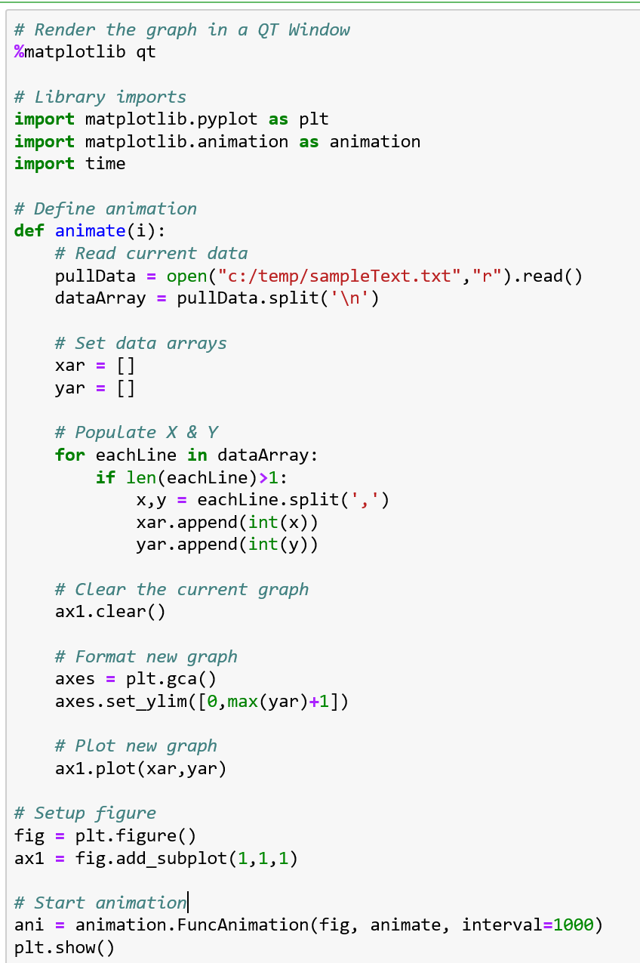
Creating a Live Graph
There are many ways to create a live graph in Jupyter, this is one
This is demonstration code. The animate subroutine does too much in one place.

Slide 9
Final Project – Extra Credit
2 points – Have the Arduino sound an alarm if the temp is +/- 20% from initial read
2 points – Display the average temperature under the graph
2 points – Have system work outside of Jupyter Notebook in addition
4 points – Draw a line on the graph corresponding to the historical average temperature for today’s date on the graph, obtained from some website
5 points – Segregate the code into modules of similar function

