Slide 1
Lecture 13
Teamwork
Bryan Burlingame
1 May 2019

Slide 2
Announcements
Lab 12 – Objects for this week
  This is the final lab, the final day of instruction is December 10, a Monday
One more lecture, introducing the final project
Final exam, groups of 3.
  Problem statement assigned next week
  May involve:
    Reading some data from some source
    Performing some operations on said data
    Writing conclusions to a file or database
    Generate visualizations to assist with understanding the data
    Interacting with the Arduino
    Providing a report about the effort
  Grading will include
    Correctness of the solution
    Quality of the code generated to solve the problem
      Clarity of the presented algorithm
      Proper partitioning of the problem into functions
      Logical mechanisms to store the data points (list vs dictionaries vs tuples vs objects)

Slide 3
Learning Objectives
Present an approach to solving a reasonably challenging problem

Slide 4
Problem Statement
Problem:¶
In a Jupyter notebook, write and document a program to compare different series representations for a multiple of Pi. Use the same format you have been using for lab reports.
Inputs¶
Allow the user to input some multiple of pi in the form Api/B. A and B should be integers. Both are optional. If either is not part of the input assume it is 1. pi, pi/2, 3pi, 32pi/17 are all valid inputs. 3.2pi is not. Invalid input should be properly rejected.
The user should also be allowed to enter the precision desired as an integer defining the number of decimal places they wish to be displayed. Any input which is not an integer should be properly rejected.
Outputs¶
A table displaying the current term number, the current approximation for the multiple of pi for four different series approximations. The table should be attractively formatted and the approximations should each be displayed in a different column.
A plot comparing the four approximations with each approximation on the y axis and the term number on the x axis.

Slide 5
First Step
Ensure you understand the problem.
What are the inputs?
A string in the form of #pi/#
What are the outputs?
A table containing estimates of pi and a graph showing the convergence
What do I not know that I need to know?
Some series approximations of pi

Slide 6
Create a framework
At a high level, think through what needs to be done and generate some code to describe this.
What needs to be done?

Slide 7
Create a framework
At a high level, think through what needs to be done and generate some code to describe this.
What needs to be done?
  Obtain the coefficient of pi in the form #pi/#
  Obtain the precision
  Generate the four series
  Display a table
  Display a graph

Slide 8
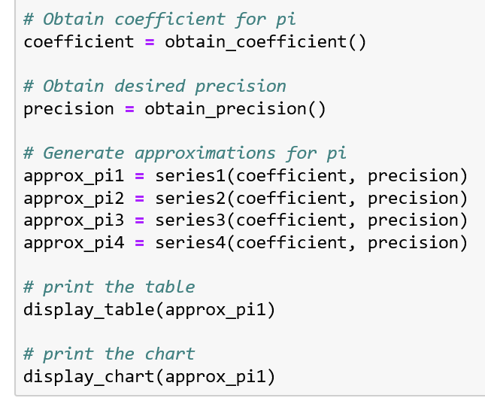
Create a framework
At a high level, think through what needs to be done and generate some code to describe this.
What needs to be done?
  Obtain the coefficient of pi in the form #pi/#
  Obtain the precision
  Generate the four series
  Display a table
  Display a graph

Slide 9
Create a framework
Note a few things:
  We haven’t defined these functions yet
  There are variables which moves the data from function to function
  At any point, we can print the contents of these variables to test how our algorithm is progressing
  Each function only implements one idea
    Separate data generation and presentation

Slide 10
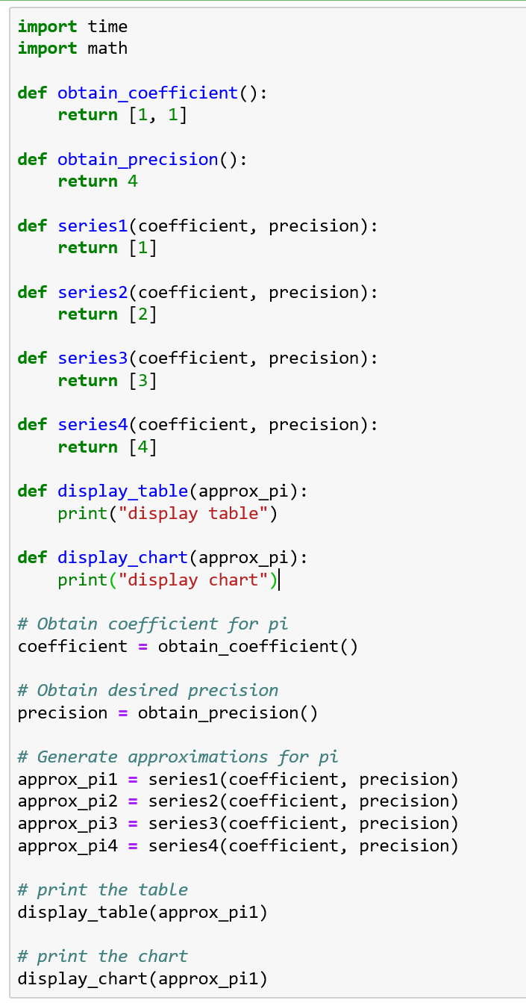
Create a framework
Extend the algorithm to a complete program
These are called “stub functions”
  All they do is implement the interfaces into each function
  This gives us a framework to begin filling out with clearly defined interfaces
  The return values should be of the proper type, but need no other meaning
  Functions which do something, yet return nothing should do something and return nothing

Slide 11
Create a framework
We revise at this level until we are certain the algorithm is correct
What did I miss?

Slide 12
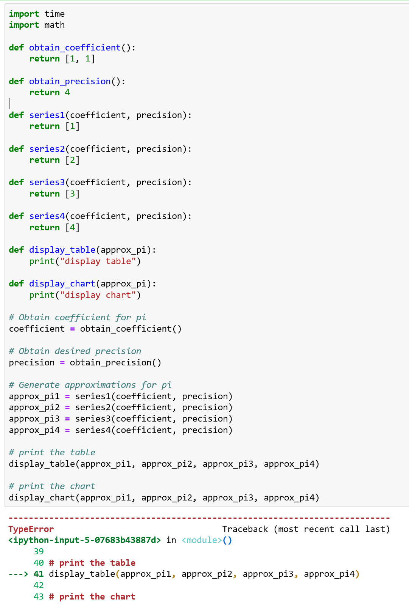
Create a framework
By focusing on the top level algorithm and the interfaces, we temporarily eliminate the details allowing for clarity
I missed that I need to include all four series in the table and the chart.
Fixing that in the algorithm, breaks the interfaces
  This is an iterative process

Slide 13
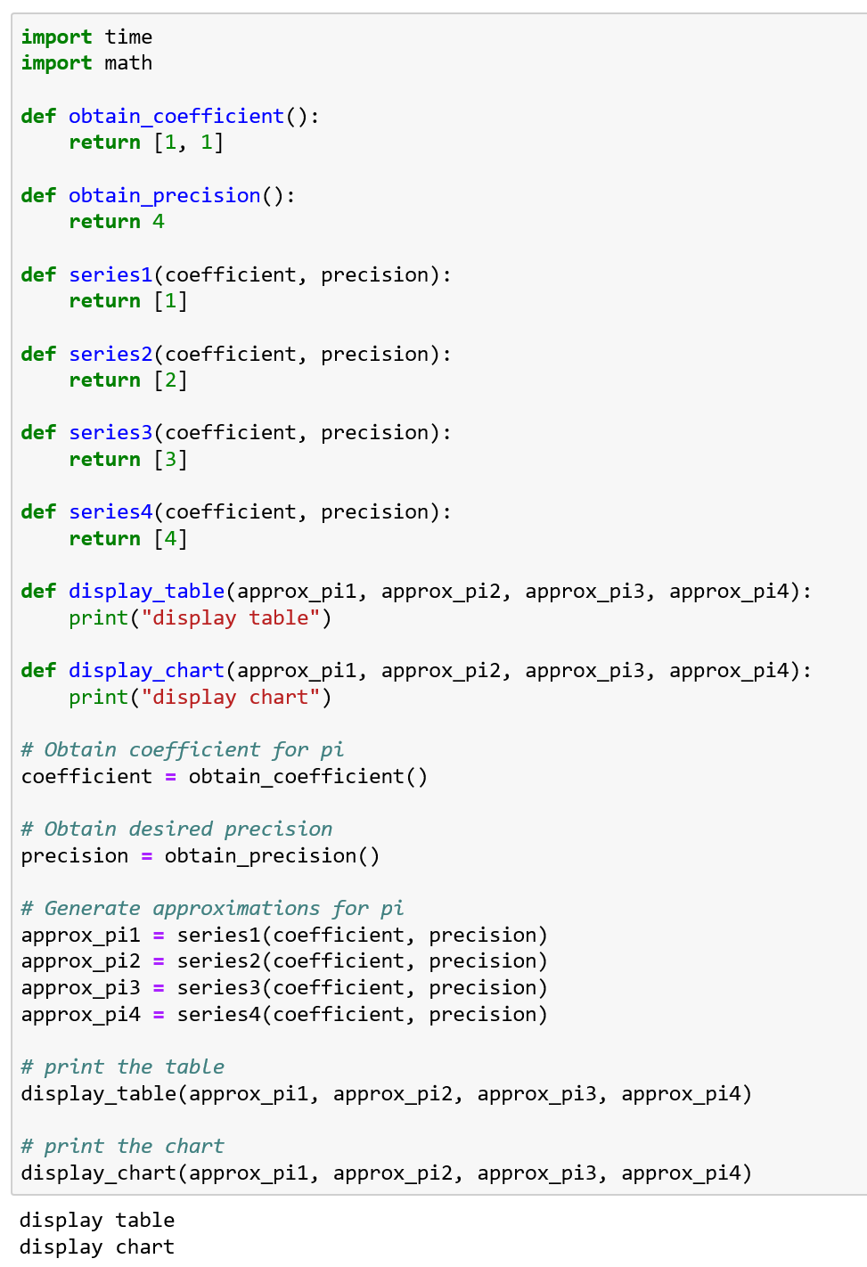
Create a framework
Now that we have a working program, we can move on

Slide 14
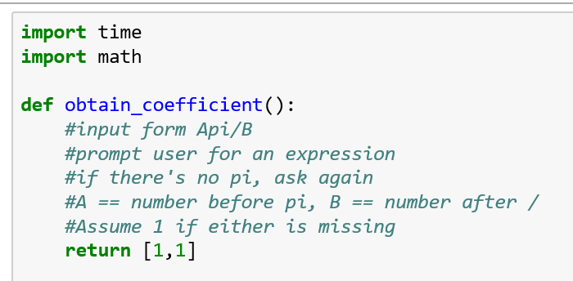
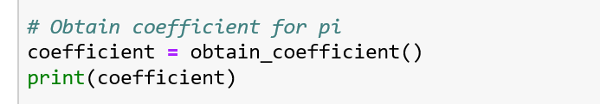
Details
With each concept packaged in a function, we can focus on implementing and testing each function in isolation
Start with generating the small algorithm in comments, then fill in each step.
Again, this allows us to develop and test by parts

Slide 15
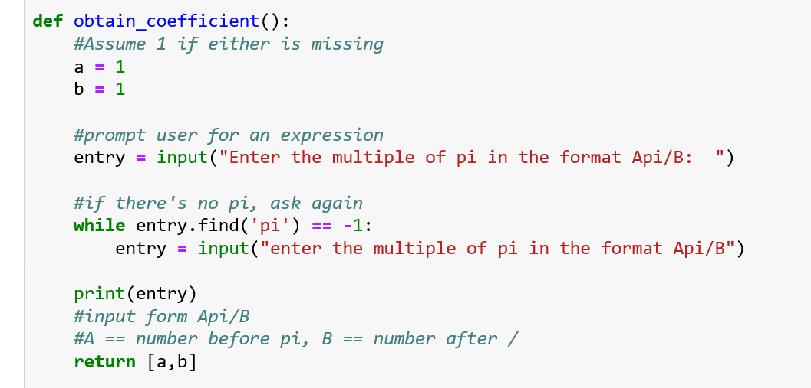
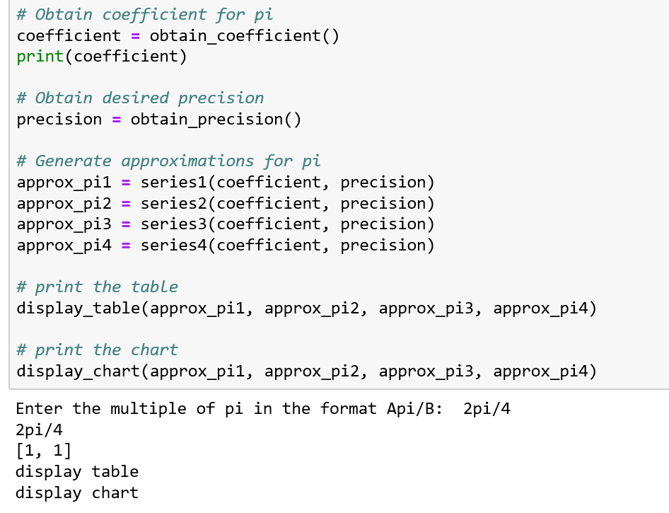
Details
By building the program up component by component, we keep the problem space small

Slide 16
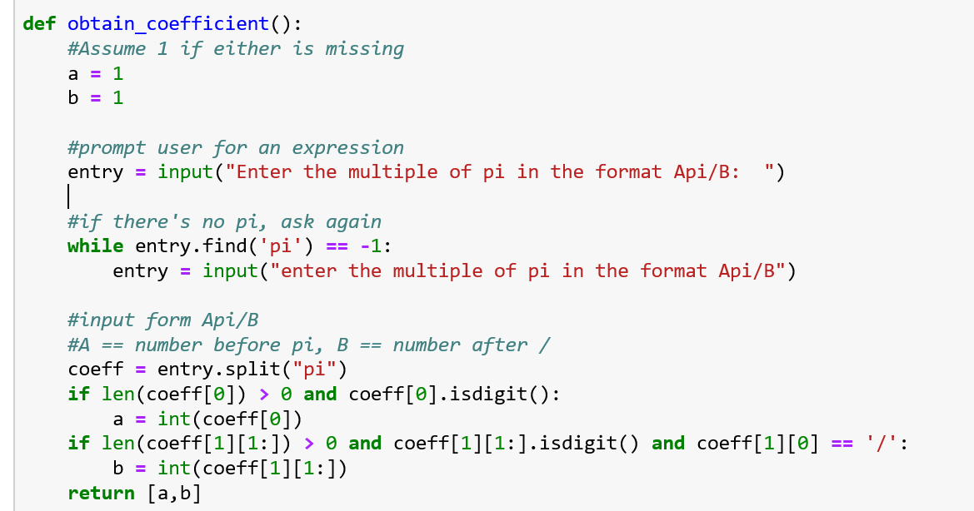
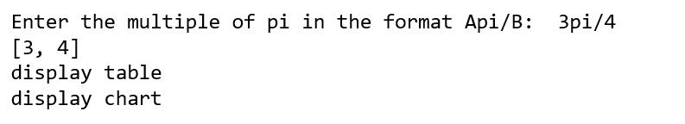
Details
With a complete framework to work with, we can readily test each set of instructions as they are added
What did I miss?

Slide 17
Details
With a complete framework to work with, we can readily test each set of instructions as they are added
What did I miss?
  What if A or B isn’t a digit? Are we handling all cases?

Slide 18
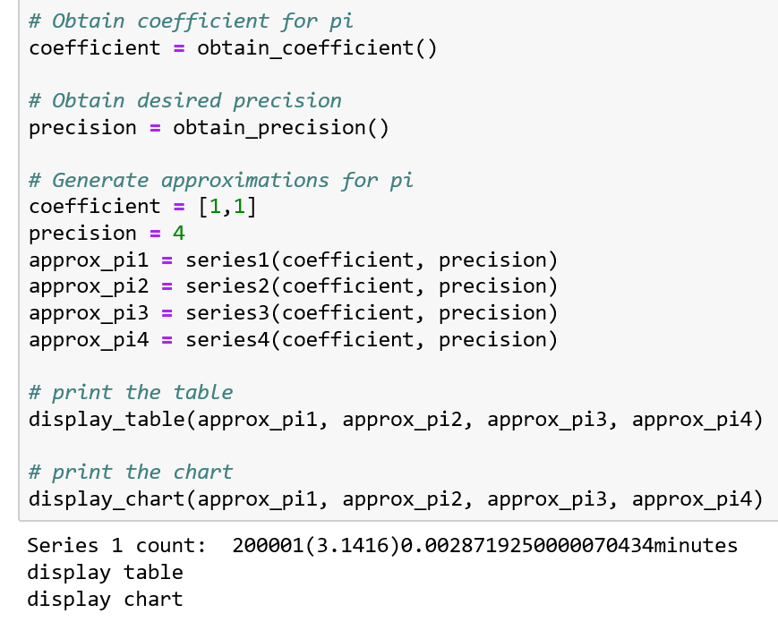
Collaboration
If the team can agree on the interfaces and function names, effectively agreeing on the framework, different team members can work on different parts
By injecting test values into the program flow, functions can be tested in isolation while ensuring the interfaces are preserved

Slide 19
Collaboration
If the team can agree on the interfaces and function names, effectively agreeing on the framework, different team members can work on different parts
By injecting test values into the program flow, functions can be tested in isolation while ensuring the interfaces are preserved
You could take this further, by having each member create their own modules

Slide 20
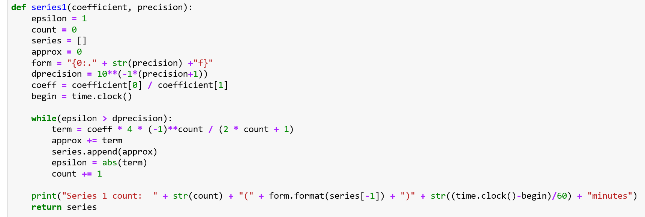
Collaboration
One team member can clearly work on this function and ensure it is correct without impacting the work of the rest of the team.

Slide 21
Integration Challenges
When the team pulls back together and attempts to replace the stub functions with the function implementations problems can occur
Most commonly an interface was misunderstood
  Ex: In this interface, the coefficient is returned from the obtain_coefficient function as a list containing [A, B], what would happen if the engineer writing the series functions assumed the coefficient was a float A/B ?

Slide 22
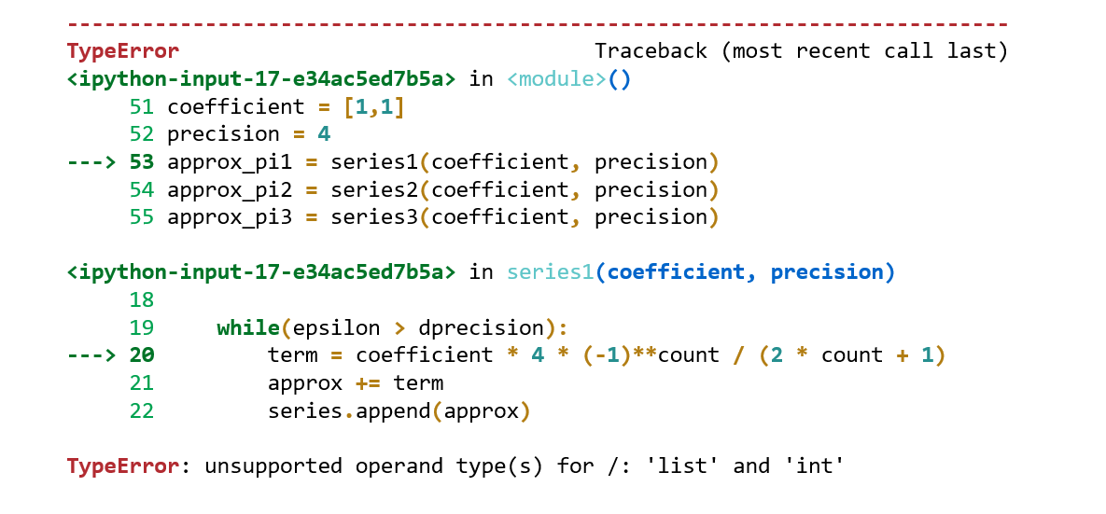
Integration Challenges
When the team pulls back together and attempts to replace the stub functions with the function implementations problems can occur
Most commonly an interface was misunderstood
  Ex: In this interface, the coefficient is returned from the obtain_coefficient function as a list containing [A, B], what would happen if the engineer writing the series functions assumed the coefficient was a float A/B ?
  When integrating, focus on the interfaces

Slide 23
Resources
Downey, A. (2016) Think Python, Second Edition Sebastopol, CA: O’Reilly Media

