Slide 1
Lecture 11
Files
Bryan Burlingame
17 April 2019

Slide 2
Announcements
Read ch. 8, 9, 10, 11 in Automate the Boring Stuff
Lab 10 should be individual effort. It will be presented to me next week for code review.

Slide 3
Learning Objectives
Introduce data persistence
Discuss file operations
Introduce exceptions
  try and except
Present simple databases
Introduce pickling
Discuss writing a module

Slide 4
Data Persistence
So far, we’ve dealt with manual input
  Some user has had to type in the data each time the program is run
  Think of the music program. Typing in the music each time is flawed.
  We need methods to store data across program executions
Data persistence is storing data in some permanent manner to be used by a program over long periods of time
  Today will talk about two: files and databases

Slide 5
Text Files
A text file is a sequence of characters read from a permanent storage device
  Files are referred to by a file name and reside at a location on the storage device
    Ex: c:\files\input.txt, a file called input.txt resides on a drive with the letter c in the path \files\
To open a file for write, use open with the ‘w’ parameter
  Ex: fout = open(“c:\files\output.txt”, “w”)
To write to a file use the write method of the file object
  Ex: fout.write(“Hello world”)
  Note: write only accepts strings

Slide 6
Filenames and Paths
Files are organized into directories (sometimes called folders)
  Directories are a tree built off of some root (called the root directory)
    C:\ is the root directory of drive C:
    Absolute path describes the path in relation to the root of the system
      C:\files\inputs\world.txt is the absolute path to the world.txt file residing in a directory inputs which is a subdirectory of files which is a subdirectory of the root of C:
  Every program runs within some current working directory (usually the directory in which the program resides)
    If the program’s path is c:\programs\my_program\my_program.py, then the current working directory at program launch is usually c:\programs\my_program
  A relative path is a path to a file relative to the current working directory
    If there was a file in c:\programs\my_program\inputs\input.txt, that file could be referred to by inputs\input.txt. This path is related to the current working directory

Slide 7
Filenames and Paths
The os object contains many useful methods
  import os
  os.getcwd() – returns the current working directory as a string
  os.path.exists(‘path\filename’) – returns true if a file or directory exists
  os.path.isdir(‘path’) – returns true if the path exists and is a directory (use with exists to determine if something is a file or a directory)
  os.path.abspath(‘relative_path\filename’) – returns the absolute path to a file
  os.listdir(‘directory) – returns a list of the files located in that directory

Slide 8
Catching Exceptions
Previously, if we had a runtime error, what happened?

Slide 9
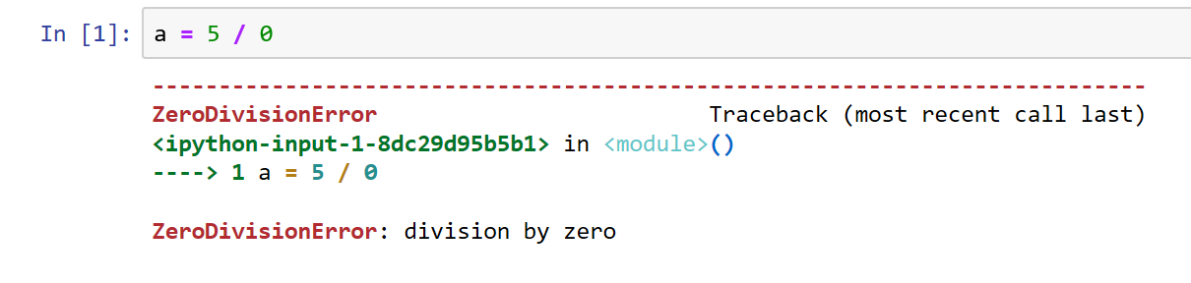
Catching Exceptions
BOOM!
Previously, if we had a runtime error, what happened?

Slide 10
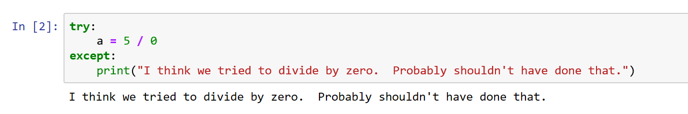
Catching Exceptions
Previously, if we had a runtime error, what happened?
There’s a way to catch the error and keep control
  try:
  except:
The program will try to run what is in the try block, if there is an error control will be handed to the except block
  This allows the programmer to clean up after errors

Slide 11
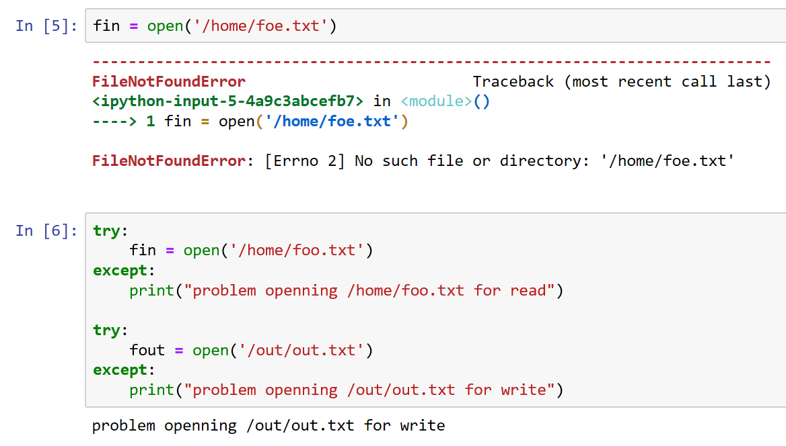
Catching Exceptions
Since a system can change outside the control of a program, putting file operations in a try block is preferred
We’ll revisit this topic in future conversations

Slide 12
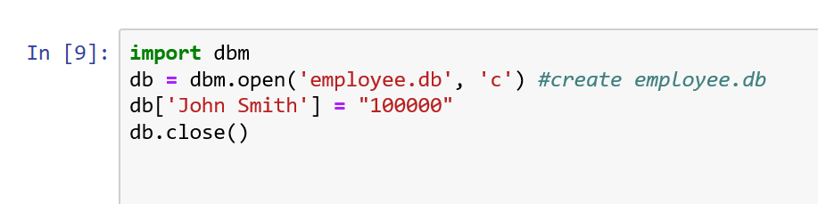
Database
A database is a file specifically organized for storing data
The dbm module gives a method to store key, value pairs on disk
  Very much like a dictionary, but persistent
dbm.open(‘db_name’, ‘c’) opens a database for read/write, creating it if it doesn’t exist
  ‘w’ opens an existing database for read/write
  ‘r’ opens an existing database for read-only (default)
  ‘n’ opens a new empty database

Slide 13
Database
A database is a file specifically organized for storing data
The dbm module gives a method to store key, value pairs on disk
  Very much like a dictionary, but persistent

Slide 14
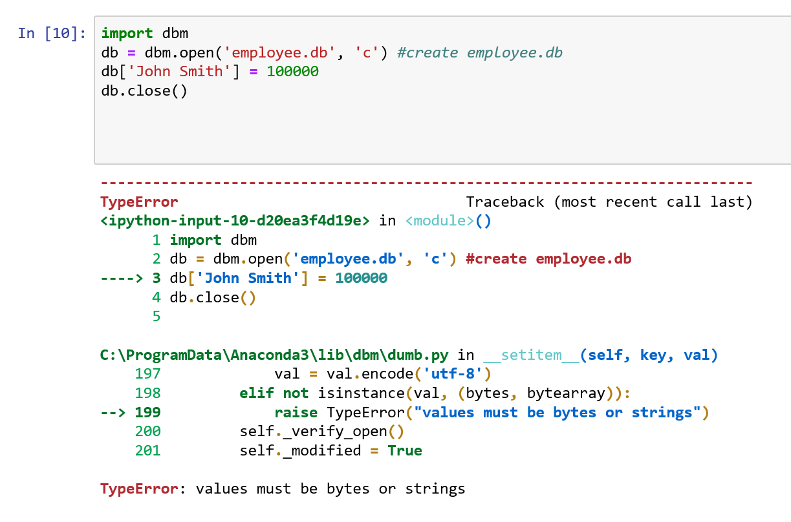
Database
A database is a file specifically organized for storing data
The dbm module gives a method to store key, value pairs on disk
  Very much like a dictionary, but persistent
Values can only be strings or bytes

Slide 15
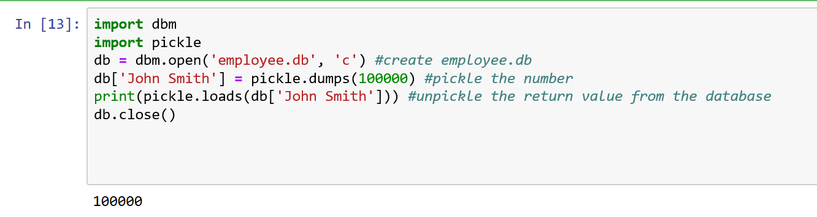
Pickling
There is a module, pickle which can work around this limitation
Pickling a value converts it to a string in a way that it can be stored in a database and then unpickled to it original value
  Use the dumps method to pickle and loads to unpickle

Slide 16
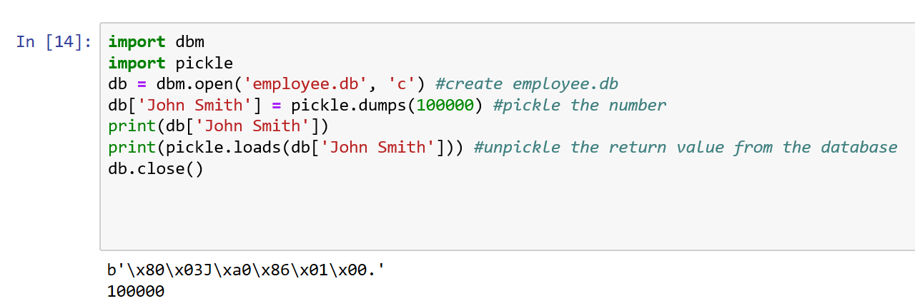
Pickling
There is a module, pickle which can work around this limitation
Pickling a value converts it to a string in a way that it can be stored in a database and then unpickled to it original value
  Use the dumps method to pickle and loads to unpickle
This works on the containers we’ve already discussed

Slide 17
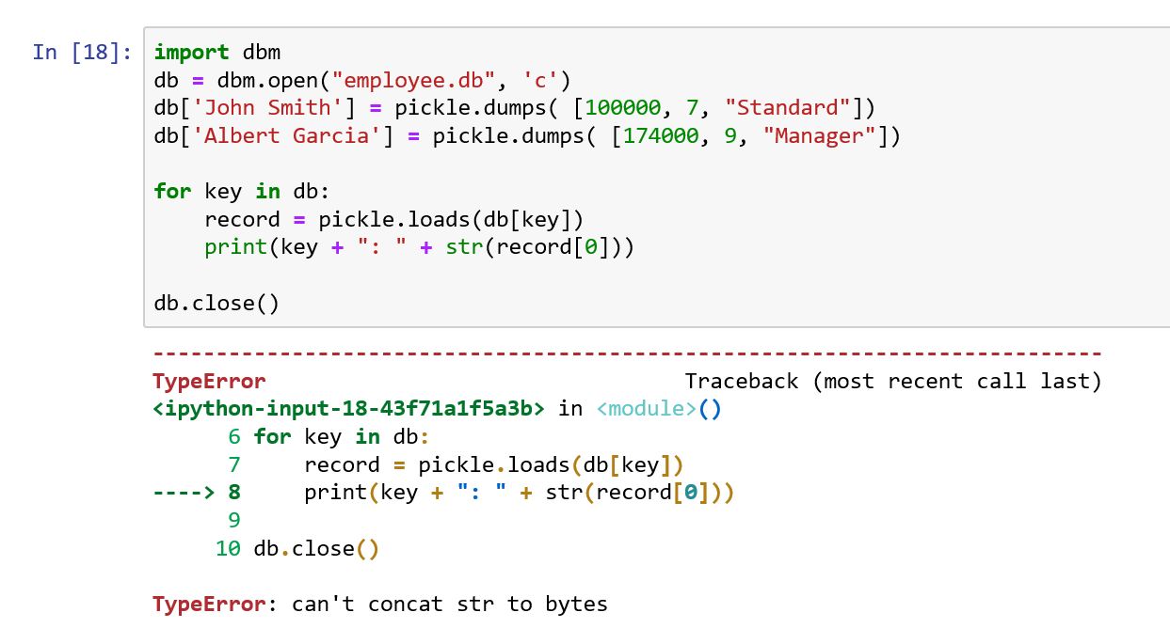
Traversing a dbm Database
The for construct can be used to traverse a dbm database just as it can for a dictionary
There is one caveat
  Keys are stored as byte objects, not strings

Slide 18
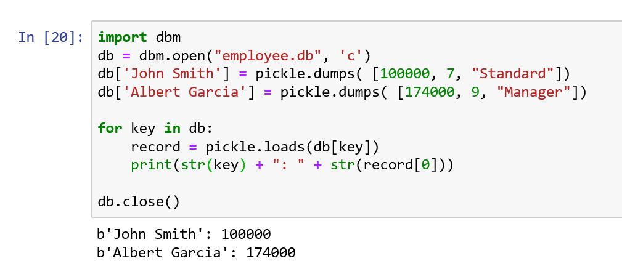
Traversing a dbm Database
The for construct can be used to traverse a dbm database just as it can for a dictionary
There is one caveat
  Keys are stored as byte objects, not strings
  We could try the str function. It kinda’ works

Slide 19
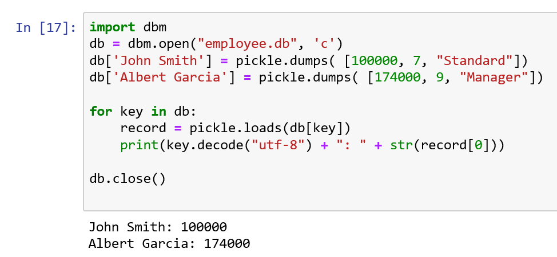
Traversing a dbm Database
The for construct can be used to traverse a dbm database just as it can for a dictionary
There is one caveat
  Keys are stored as byte objects, not strings
  We could try the str function. It kinda’ works
  To convert a byte object to a string, use the decode method with utf-8 as the decode type

Slide 20
Resources
Downey, A. (2016) Think Python, Second Edition Sebastopol, CA: O’Reilly Media
(n.d.). 3.7.0 Documentation. 5. Data Structures — Python 3.7.0 documentation. Retrieved October 30, 2018, from https://docs.python.org/3/tutorial/datastructures.html

