Slide 1
Lecture 11
Tuples
Bryan Burlingame
Halloween 2018

Slide 2
Announcements
Homework 8 due up front
Homework 9 due next week
Read ch. 13, 14, & 21

Slide 3
Learning Objectives
Introduce and discuss tuples
Identify the similarities and differences between tuples and lists
Craft functions with variable numbers of arguments

Slide 4

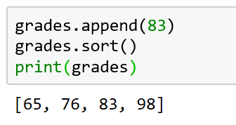
Lists and Sequences
Recall: lists are a sequence of values connected by a common name
Lists have many methods to manipulate their contents
Methods are functions attached to some object and are accessed via the . operator

Slide 5
Tuples
Tuples are sequences of values much like lists with one very key and very important difference:
  Lists are mutable, they can be changed
  Tuples are immutable, they cannot be changed
    Though they may store mutable items
  Tuples are written as sequences of values separated by commas, sometimes in parenthesis

Slide 6
List vs Tuples
Lists
| append(...) | L.append(object) -> None -- append object to end |
| clear(...) | L.clear() -> None -- remove all items from L |
| copy(...) | L.copy() -> list -- a shallow copy of L |
| count(...) | L.count(value) -> integer -- return number of occurrences of value |
| extend(...) | L.extend(iterable) -> None -- extend list by appending elements from the iterable |
| index(...) | L.index(value, [start, [stop]]) -> integer -- return first index of value. | Raises ValueError if the value is not present. |
| insert(...) | L.insert(index, object) -- insert object before index | | pop(...) | L.pop([index]) -> item -- remove and return item at index (default last). | Raises IndexError if list is empty or index is out of range. |
| remove(...) | L.remove(value) -> None -- remove first occurrence of value. | Raises ValueError if the value is not present. |
| reverse(...) | L.reverse() -- reverse *IN PLACE* |
| sort(...) | L.sort(key=None, reverse=False) -> None -- stable sort *IN PLACE*
Tuples
| count(...) | T.count(value) -> integer -- return number of occurrences of value |
| index(...) | T.index(value, [start, [stop]]) -> integer -- return first index of value. | Raises ValueError if the value is not present.

Slide 7
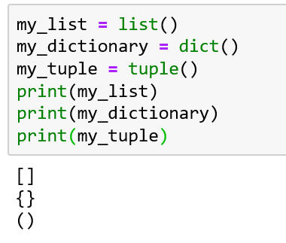
Declaring a Tuple
Declaring a tuple can be accomplished by invoking the tuple() function
Notice the difference in the brackets
  Square brackets [] indicate a list
  Curly brackets {} indicate a dictionary
  Parenthesis () indicate a tuple

Slide 8
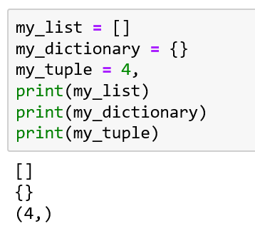
Declaring a Tuple
Unlike with lists and dictionaries, a parenthesis alone cannot create a tuple
  This would cause a grammar conflict with the use of parenthesis in a mathematical context
  A tuple can be implicitly declared with at least one value and a comma
  Since it cannot be changed, an empty tuple is not terribly useful

Slide 9
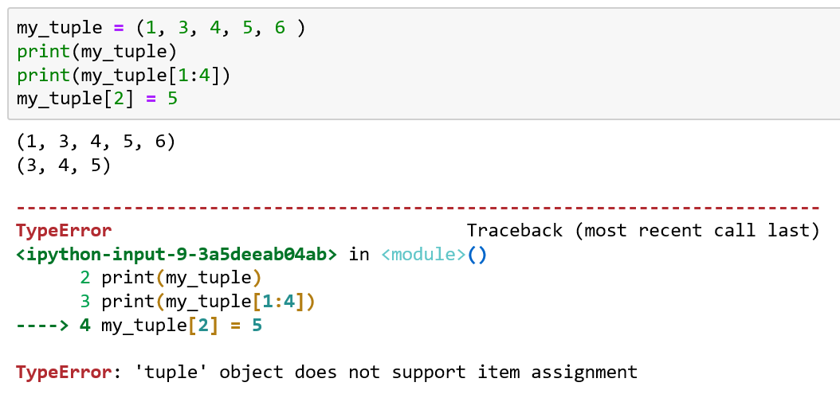
Using Tuples
Most list operations can be used such as slices and the len function work on tuples as they do on lists
Attempting to change a value in a tuple generates an error

Slide 10
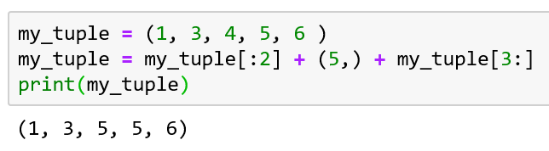
Using Tuples
It is possible to copy and concatenate tuples
  Combining these operations, allow the simulation of changing a member
  This is expensive, changing a list accesses one value. Copying a tuple changes the number of values which exist in the tuple.

Slide 11
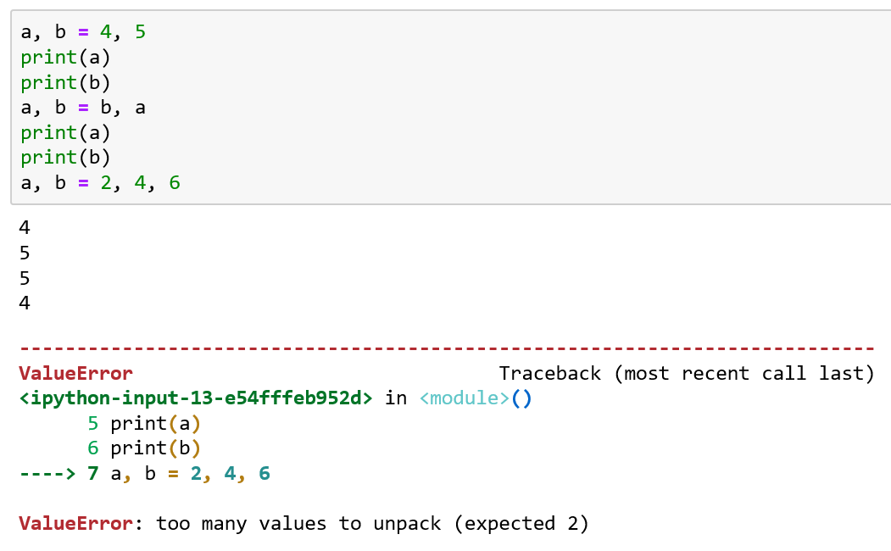
Tuple Assignments
It is possible use a Tuple on the left-hand side of an assignment operator
The left and right sides must be balanced, each tuple must have the same number of members

Slide 12
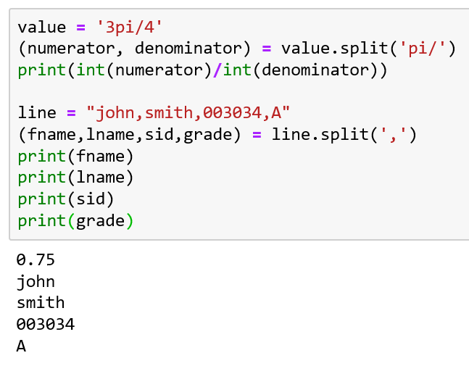
Tuple Assignments
Functions and methods which return a tuple can be used with Tuple assignment
  Ex: split returns a tuple of the values in a string separated by some string

Slide 13
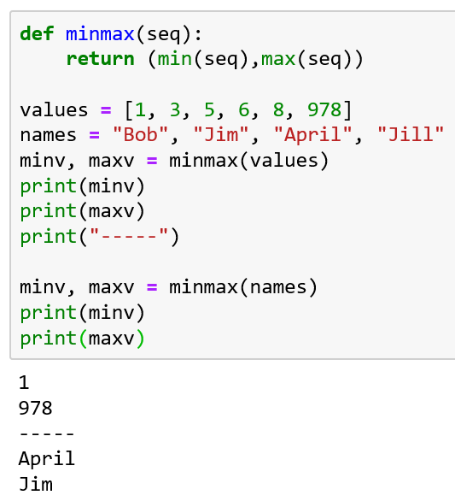
Tuple Assignments
Though a function can only return one value, that value can be a tuple
Combined with a matching Tuple Assignment, the appearance of returning multiple values is possible
Note: if the values passed in are not changed, functions can frequently work on lists and tuples interchangeably

Slide 14
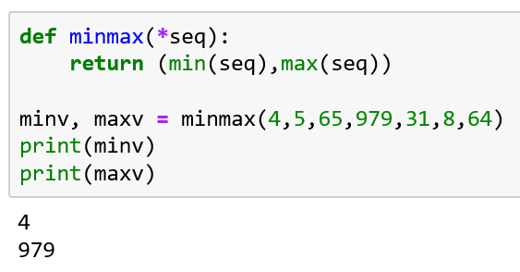
Variable Arguments
By prefacing an argument to a function with an * asterisk, all values are gathered into a tuple
The number of arguments in the function call can be arbitrary

Slide 15
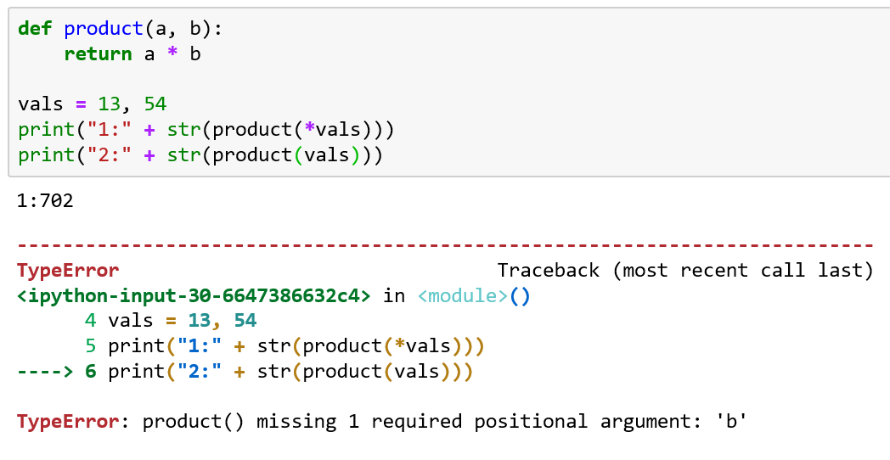
Splitting Tuples
Corresponding to the gather operation, a tuple can be scattered to its individual values in a function call by using the same * asterisk operator
  Note the first call works, the vals tuple separates into two discrete values and then are passed into the function
  The second call doesn’t perform the scatter and fails

Slide 16
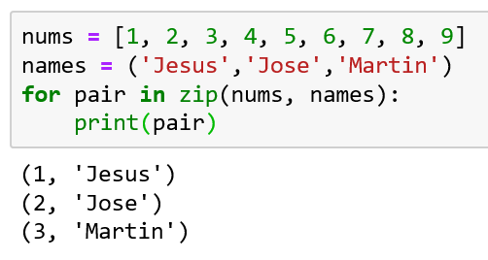
Lists and Tuples
Two sequences can be joined, element by element using the zip function
zip returns a sequence of pairs comprised of one element from each sequence in a zip object
The zip object is an iterator. Iterators are used to iterate over a set of data
Note: the sequence of pairs the length of the shorter seq
Only prints three entries
since names only has three
entries

Slide 17
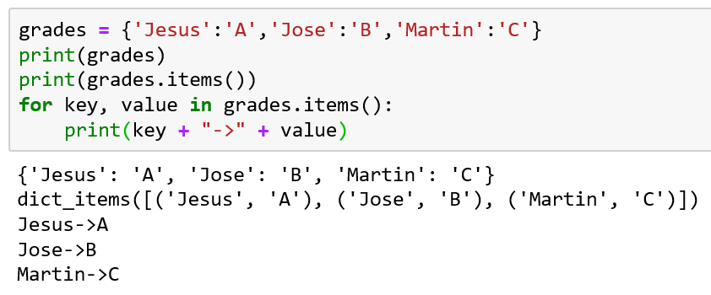
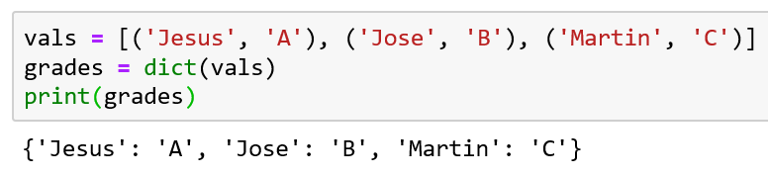
Dictionaries and Tuples
There is a method for dictionary objects, items, which returns a sequence of (key, value) tuples
The result is a dict_items iterator which can be used to iterate over the dictionary
A list of tuples can be used to initialize a dictionary

Slide 18
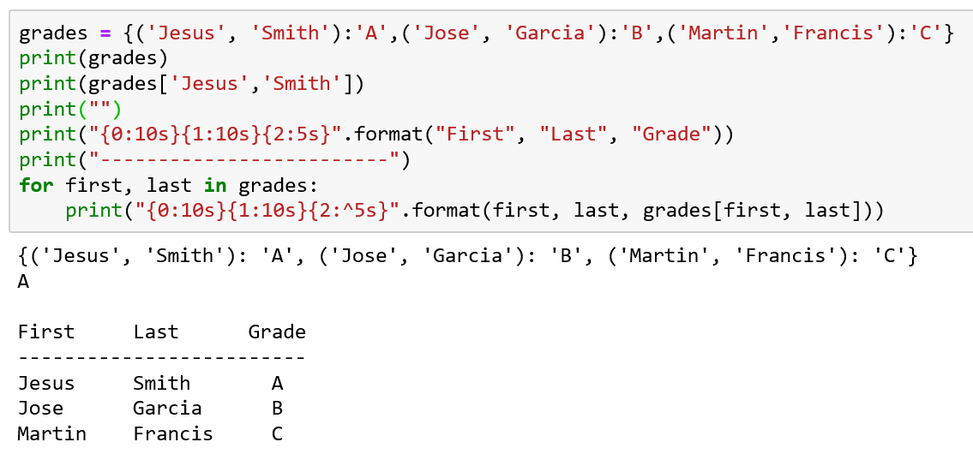
Dictionaries and Tuples
Recall: the key to a dictionary can be any immutable value
Recall: tuples are immutable

Slide 19
Resources
Downey, A. (2016) Think Python, Second Edition Sebastopol, CA: O’Reilly Media
(n.d.). 3.7.0 Documentation. 5. Data Structures — Python 3.7.0 documentation. Retrieved October 30, 2018, from https://docs.python.org/3/tutorial/datastructures.html

