Slide 1
Lecture 5
Fruitful Functions
Bryan Burlingame
27 February 2019

Slide 2
Announcements
Homework 3 due up front
Read Chapter 7 & 20

Slide 3
Learning Objectives
Revisit functions and discuss return values
Incremental development
None as a value

Slide 4
Revisiting Functions
Recall: Functions are named sequences of instructions which perform some action
  Functions accept parameters in a parameter list and return values
  A function call is the activation of a function
  Python has many built in functions and many additional useful modules
  Modules are collections of functions with similar purpose
    Example: the math module with sin, cos, tan, etc.
Functions are defined with the def keyword

Slide 5
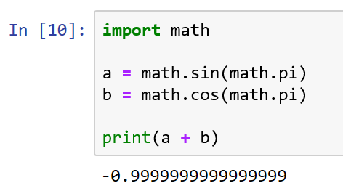
Fruitful Functions
Allen Downey defines a fruitful function as a function which returns a value defined by the programmer
The value a function returns is simply called the return value
We have been using fruitful functions for some time
  ex: math.sin(angle) and math.cos(angle) are both fruitful functions

Slide 6
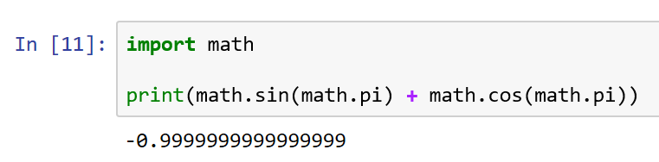
Fruitful Functions
Allen Downey defines a fruitful function as a function which returns a value defined by the programmer
The value a function returns is simply called the return value
We have been using fruitful functions for some time
  ex: math.sin(angle) and math.cos(angle) are both fruitful functions
  Recall: one can use a function call anywhere the return value can be used

Slide 7
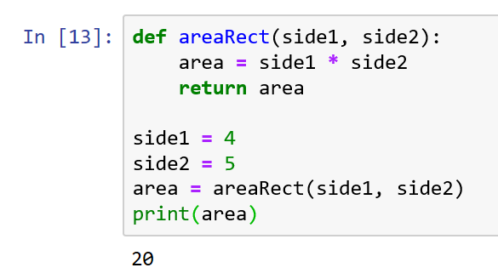
Defining Fruitful Functions
A return value is identified using the return keyword
Parameter list
Function definition
Return value
Function call

Slide 8
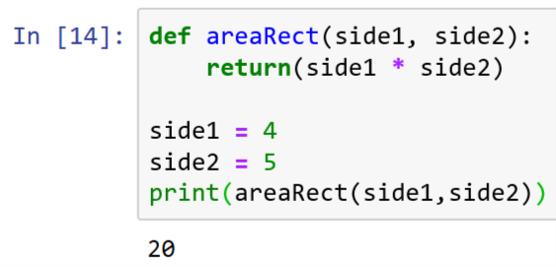
Refactoring
Recall refactoring is the process of restructuring some set of code without changing its function
In this example, I’ve refactored both the areaRect function and __main__. Which is superior?

Slide 9
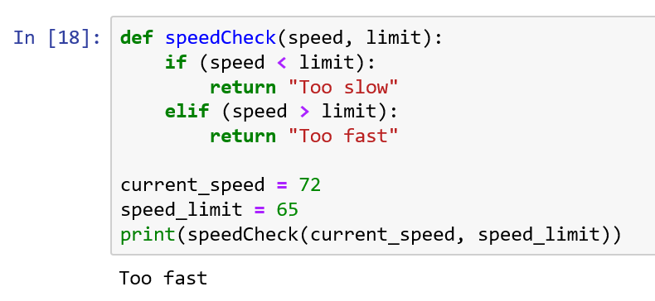
Return values
Multiple return statements are allowed, though the first return executed ends the function and returns the return value

Slide 10
Return values
Multiple return statements are allowed, though the first return executed ends the function and returns the return value
What’s the return value if the current speed == the speed limit?

Slide 11
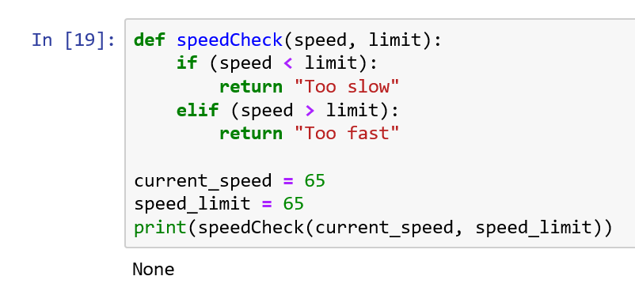
Return values
Multiple return statements are allowed, though the first return executed ends the function and returns the return value
None is the default return value. All void functions actually have a return value: None

Slide 12
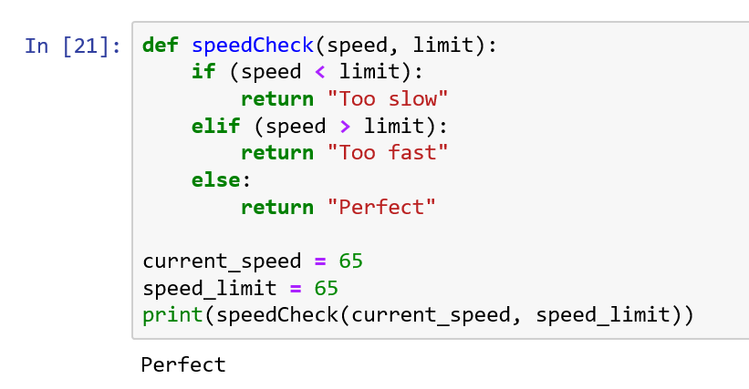
Return values
All branches in a function should return a value
None is the default return value. All void functions actually have

Slide 13
Composition
Recall: a function can be called from within another function
Problem: find area of a rectangle, given coordinates of opposite corners
(12,12)
(1,1)

Slide 14
Algorithm
Recall: An algorithm is an ordered set of instructions defining some process
What is the algorithm necessary to find the area of a rectangle, given the points of the corners?

Slide 15
Algorithm
Recall: An algorithm is an ordered set of instructions defining some process
What is the algorithm necessary to find the area of a rectangle, given the points of the corners?
  Obtain the two points
  Calculate the length of each side
  Multiply the lengths of the two sides together to obtain the area
  Return the area

Slide 16
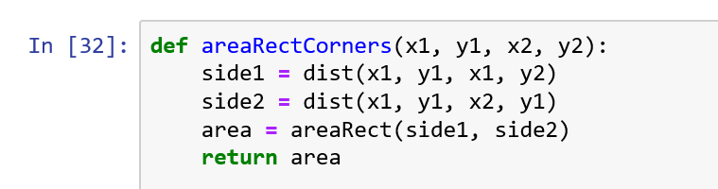
Algorithm
Recall: An algorithm is an ordered set of instructions defining some process
What is the algorithm necessary to find the area of a rectangle, given the points of the corners?
  Obtain the two points
  Calculate the length of each side
  Multiply the lengths of the two sides together to obtain the area
  Return the area

Slide 17
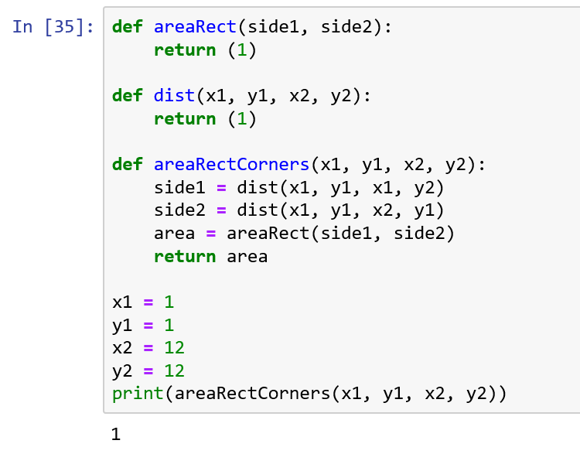
Incremental Development
Incremental development is the process of developing a program in small chunks (increments)
Stub functions are functions which only implement the interfaces (parameter lists and return values) to allow for incremental development
Note how areaRect and dist do not do anything, but they do accept the proper values and the do return a value of the proper type

Slide 18
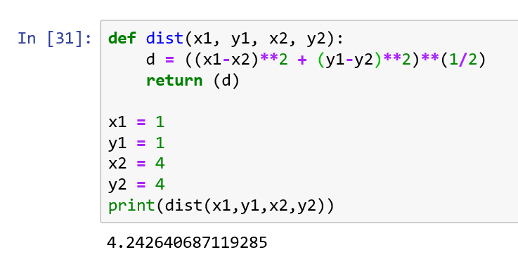

Algorithm
The distance between two points uses the distance formula
$$distance=\sqrt{{(X_{1}−X_{2})}^{2} −{(Y_{1}−Y_{2})}^{2}}$$

Slide 19
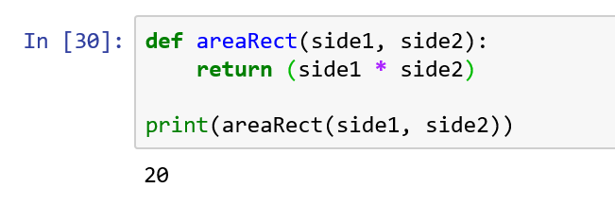
Algorithm
Area of a rectangle is height * width
Note how each function is being tested independently

Slide 20
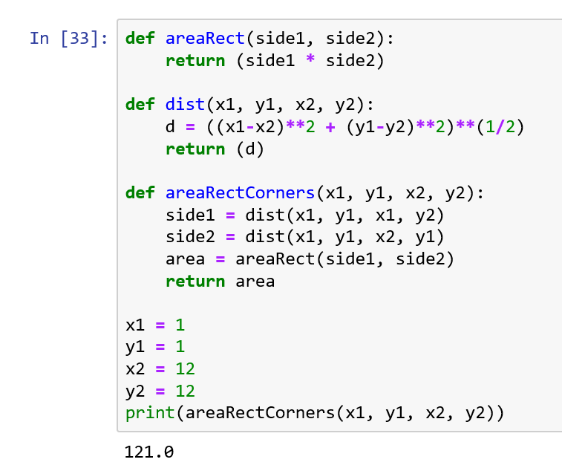
Incremental Development
By building up the program in increments we can test each function separately
This allows us to focus on one part at a time
Get one thing working before moving on to the next

Slide 21
Recursion Revisited
Recursion becomes useful, once each call can return values to the previous call
What’s the general algorithm to calculate a factorial
  n == 0? Return 1
  otherwise return n * factorial(n-1)

Slide 22
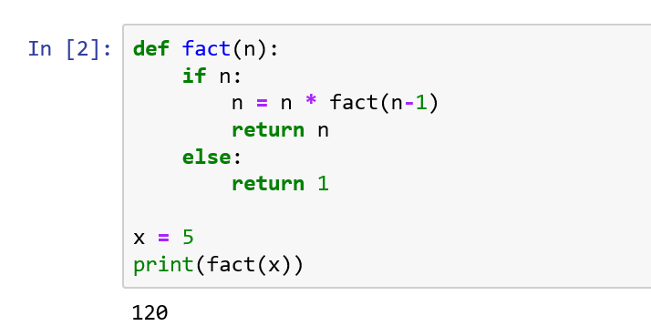
Recursion Revisited
Recursion becomes useful, once each call can return values to the previous call
What’s the general algorithm to calculate a factorial
  n == 0? Return 1
  otherwise return n * factorial(n-1)
How good is this?

Slide 23
Recursion Revisited
Recursion becomes useful, once each call can return values to the previous call
What’s the general algorithm to calculate a factorial
  n == 0? Return 1
  otherwise return n * factorial(n-1)
How good is this?
  What is fact(1.5)?
  What is fact(-1)

Slide 24
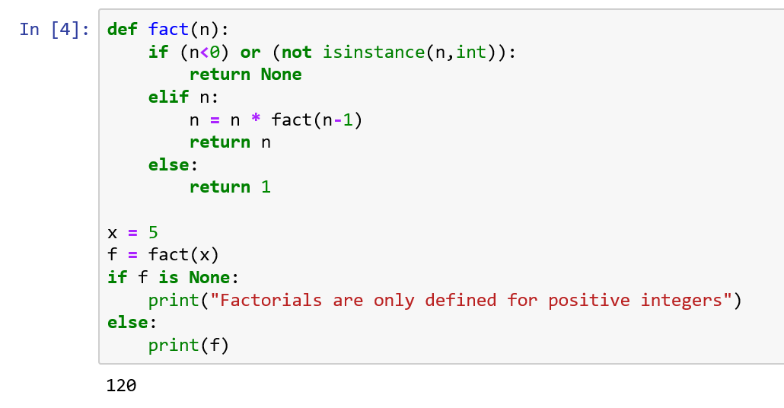
Recursion Revisited
Better
Test for invalid values and then return None when something is invalid, the text calls this a guardian
  Data validation, bounds check
None is not a number, it is the absence of an answer
Use the is operator to test for None (== works in the simple cases, ‘is’ is better)
Note that we now have multiple base cases for this function
Note the isinstance function, which can be used to check datatype

Slide 25
Resources
Downey, A. (2016) Think Python, Second Edition Sebastopol, CA: O’Reilly Media
(n.d.). 3.7.0 Documentation. 6. Expressions — Python 3.7.0 documentation. Retrieved September 11, 2018, from http://docs.python.org/3.7/reference/expressions.html

