Slide 1
Lecture 4
Conditions & Recursion
Bryan Burlingame
20 February 2019

Slide 2
Announcements
Homework 2 due up front
Read Chapter 6
Homework 3 due next week
Office hours: Eng 213, 6PM - ?

Slide 3
Learning Objectives
Introduce integer division
Introduce Boolean Arithmetic
Discuss conditionals (flow control)
Explore recursive algorithms
Begin accepting input from the keyboard

Slide 4
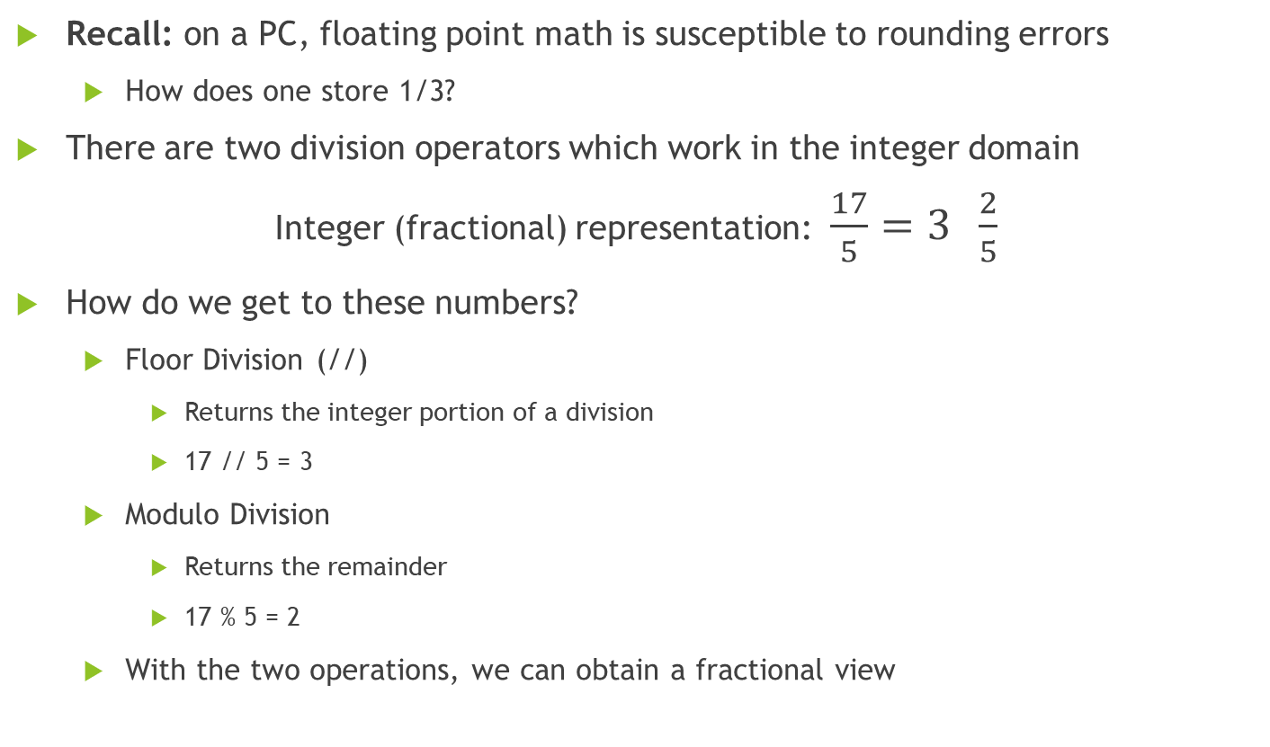
Integer Division
Recall: on a PC, floating point math is susceptible to rounding errors
  How does one store 1/3?
There are two division operators which work in the integer domain
Integer (fractional) representation: $\frac{17}{5}=3 \frac{2}{5}$
How do we get to these numbers?
  Floor Division (//)
    Returns the integer portion of a division
    17 // 5 = 3
  Modulo Division
    Returns the remainder
    17 % 5 = 2
  With the two operations, we can obtain a fractional view

Slide 5

Integer Division
Recall: on a PC, floating point math is susceptible to rounding errors
  How does one model store 1/3?
There are two division operators which work in the integer domain
Integer (fractional) representation: $\frac{17}{5}=3 \frac{2}{5}$
How do we get to these numbers?
  Floor Division (//)
    Returns the integer portion of a division
    17 // 5 = 3
  Modulo Division
    Returns the remainder
    17 % 5 = 2
  With the two operations, we can obtain a fractional view

Slide 6
Applications of Integer Division
How could we obtain just the 1’s place of a number? (ex. Given 153, we want the 3)

Slide 7
Applications of Integer Division
How could we obtain just the 1’s place of a number? (ex. Given 153, we want the 3)
  Use modulo division 153 % 10 = 3 (assuming base 10)

Slide 8
Applications of Integer Division
How could we obtain just the 1’s place of a number? (ex. Given 153, we want the 3)
  Use modulo division 153 % 10 = 3 (assuming base 10)
How can we check to see if one number is evenly divisible by another? (ex. Is 57 evenly divisible by 3?)

Slide 9
Applications of Integer Division
How could we obtain just the 1’s place of a number? (ex. Given 153, we want the 3)
  Use modulo division 153 % 10 = 3 (assuming base 10)
How can we check to see if one number is evenly divisible by another? (ex. Is 57 evenly divisible by 3?)
  Check to see if the remainder is zero ( does 57 % 3 == 0 ?)
  How can we use this to detect oddness or evenness?

Slide 10
Boolean Algebra
Named after Mathematician George Boole who introduced these concepts to the world in “The Mathematical Analysis of Logic”
Concepts are either logically true or logically false
  Boolean Algebra supports two values, True and False
    In most of computer science, including Python, 0 is considered false. Not zero is true.
Uses relational and logical operators
Note how this lines up to a machine which only works with 0s and 1s

Slide 11
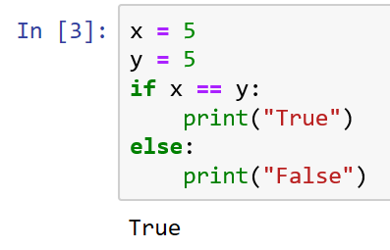
Relational Operators
Assignment
Equivalence test
Recall: Python uses the = operator to assign a value to a variable
Equivalence == (two equal signs)
Using a single = for an equivalence test will generate a syntax error

Slide 12
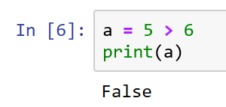
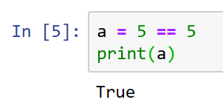
Relational Operators
Operation | Meaning
X == Y | True when X is equal to Y
X != Y | True when X is not equal to Y
X > Y | True when X is greater than Y
X < Y | True when X is less than Y
X >= Y | True when X is greater than or equal to Y (logically inverted from X < Y)
X <= Y | True when X is less than or equal to Y (logically inverted from X > Y)
Each of these operators return a value of type Boolean. That value can be stored.

Slide 13
Logical Operators
Operators to link Boolean expressions together to create more complex semantics
Operator | Function
X and Y | True if and only if X is true and Y is true
X or Y | True if X is true or Y is true
not X | True if X is false, false if X is true

Slide 14
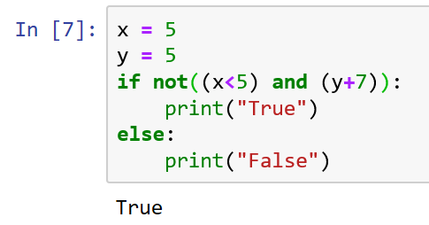
Logical Operators
Operators to link Boolean expressions together to create more complex semantics
Operator | Function
X and Y | True if and only if X is true and Y is true
X or Y | True if X is true or Y is true
not X | True if X is false, false if X is true

Slide 15
Logical Operators
Operators to link Boolean expressions together to create more complex logical expressions
Operator | Function
X and Y | True if and only if X is true and Y is true
X or Y | True if X is true or Y is true
not X | True if X is false, false if X is true
Note the use of parenthesis and the mixing of various operators

Slide 16
Order of Operations (Precedence)
Operator
()
**
+ - (unary)
* / % //
+ - (binary)
< <= > >=
== !=
= %= /= //= -= += *= **=
not
and
or
As in traditional Algebra, operators at the same level of precedence are evaluated from left to right

Slide 17
Conditional Execution
X = 5
Y = 5
Sometimes called alternation or decisions
Run a set of statements, if some condition is true
X == Y
True
False
Print “True”

Slide 18
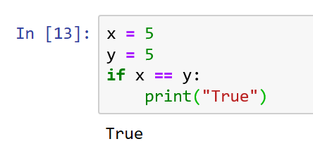
Conditional Execution
X = 5
Y = 5
Sometimes called alternation or decisions
Run a set of statements, if some condition is true
Uses the if keyword
All indented commands run
  There isn’t a reasonable limit to the number of commands
The logic controlling whether the instructions run is called the boundary condition
(x == y) is the boundary condition in this example
X == Y
True
False
Print “True”

Slide 19
Alternative Execution
X = 5
Y = 5
If a condition is true, run a set of commands, if it is false run a different set of commands
Uses the if and else keywords
X == Y
True
False
Print “False”
Print “True”

Slide 20
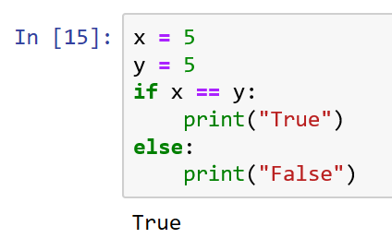
Alternative Execution
X = 5
Y = 5
If a condition is true, run a set of commands, if it is false run a different set of commands
Uses the if and else keywords
X == Y
True
False
Print “False”
Print “True”

Slide 21
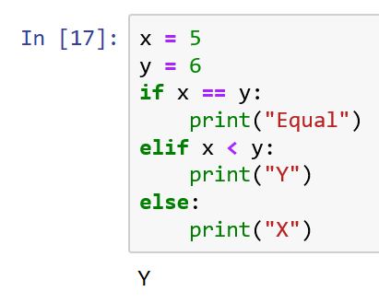
Chained Conditionals
False
X == Y
True
F
X < Y
T
Print “Equal”
Decisions can be linked in a chain allowing for a choice of many alternatives
Uses the if, elif and else keywords
Note: the order matters. The flow is directed down the first true conditional
Print “X”
Print “Y”

Slide 22
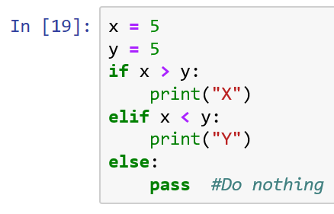
Chained Conditionals
False
X > Y
True
F
X < Y
T
Print “Equal”
When testing code, ensure your test cases go down every branch in every conditional
If there is an elif, there should always be an else
  We want the decision tree to be complete
  It is ok if the else case does nothing. To indicate that it does nothing, use the pass keyword
Print “Y”

Slide 23
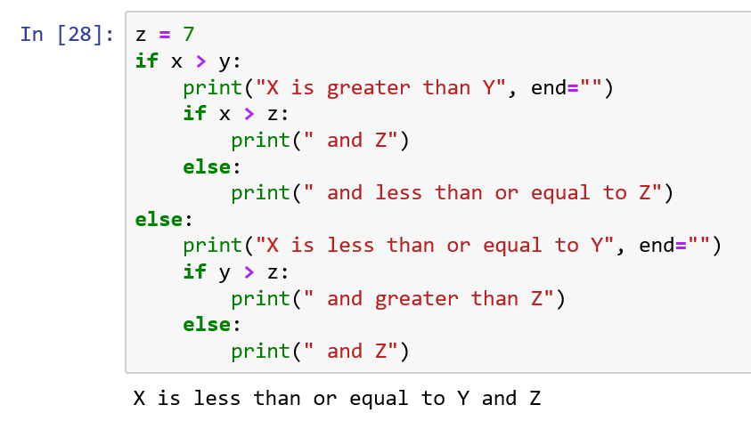
Nesting Logic
All conditional operations can be nested
  Nested is when there is a conditional within the program instructions gated by some other condition
  Note the indentation. In python that indentation is required and is considered part of the grammar of the language
  Note the “or equal” clauses in the print statements
  Generally, if your logic is nested more than a few layers deep, see if there is a more obvious way to write the code
# end=“” suppresses the newline/carriage return

Slide 25
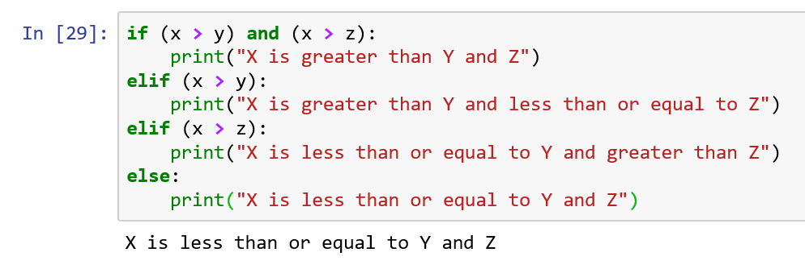
Code
Refactoring
The process of restructuring existing code without changing its external meaning

Slide 26
Code
Refactoring
The process of restructuring existing code without changing its external meaning
Which version is better?

Slide 27
Recursion – Inception comes to Python
Recall: functions are modular segments of code which can be called from elsewhere in the program through a well-defined interface
In this definition, are there limits to where a function can be called?

Slide 28
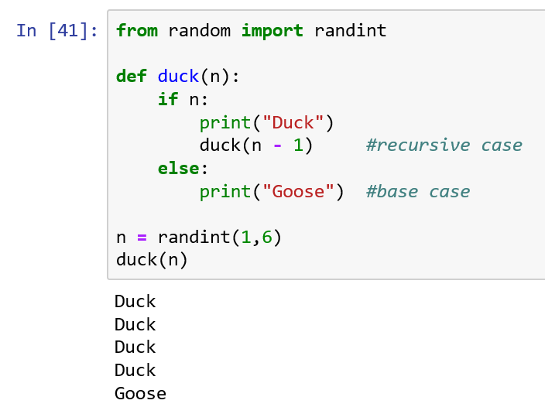
Recursion – Inception comes to Python
Recall: functions are modular segments of code which can be called from elsewhere in the program through a well-defined interface
In this definition, are there limits to where a function can be called?
No !
It is totally possible for a function to call itself, this is called recursion

Slide 29
Stack Diagram
Recall: Stack diagrams are diagrams showing the function calls, variables used, and the values passed between them
What does this stack diagram look like?
How many function calls are here?

Slide 30
Stack Diagram
__main__
n -> 4
duck
n -> 3
duck
n -> 2
duck
n -> 1
duck
n -> 0

Slide 31
Infinite Recursion
The base case of a recursive function is the case which stops the recursion (it shows up as the base of the Stack Diagram)
All recursive functions must have a base case
  What is the base condition which leads to the base case in duck()?

Slide 32
Infinite Recursion
The base case of a recursive function is the case which stops the recursion (it shows up as the base of the Stack Diagram)
All recursive functions must have a base case
  What is the base condition which leads to the base case in duck()?
  The base condition is n == 0

Slide 33
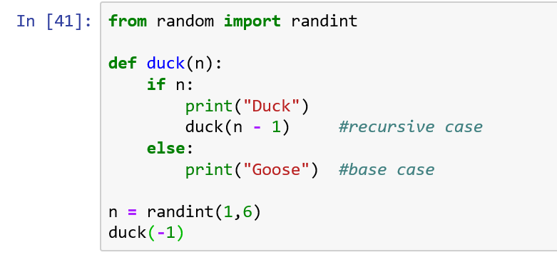
Infinite Recursion
What happens if the base condition never triggers?
What will happen in this case, where we call duck with -1 as the parameter?

Slide 34
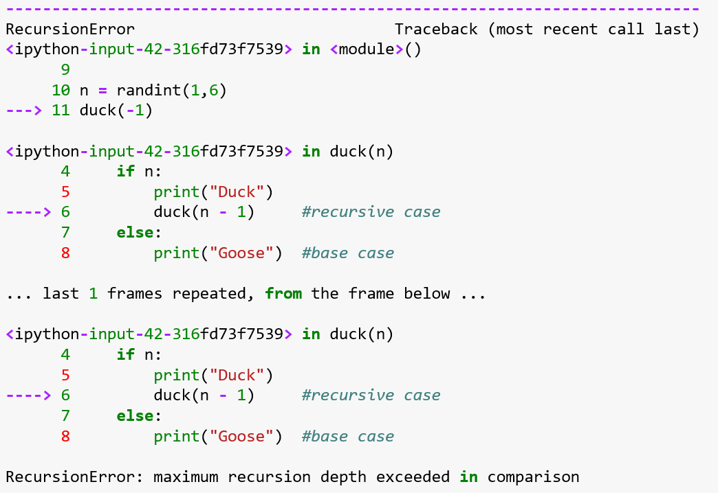
Infinite Recursion
BOOM!
After about 1,000 ducks, and 1,000 functions still waiting to end, the stack overflows and the program stops
This is called infinite recursion, and it is a bug
If this happens, ensure:
  There is a base case
  The base case is guaranteed to execute
  The base case does not recurse
Which bug did I introduce?

Slide 35
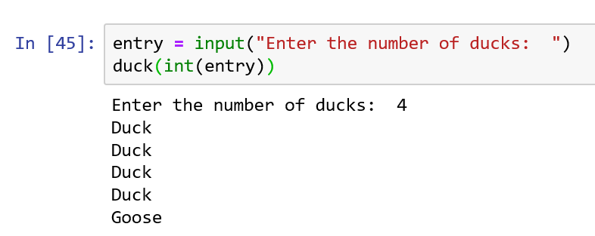
Input
We can use the input function to accept text from the user
Input returns a string
  If we want a number, we need to convert that string to a number using a conversion function
    int, float

Slide 36
Resources
Downey, A. (2016) Think Python, Second Edition Sebastopol, CA: O’Reilly Media
(n.d.). 3.7.0 Documentation. 6. Expressions — Python 3.7.0 documentation. Retrieved September 11, 2018, from http://docs.python.org/3.7/reference/expressions.html

