Slide 1
Lecture 3
Functions
Bryan Burlingame
13 February 2019

Slide 2
Announcements
Labs are due at the start of lab
Read chapters 4 & 5
Homework 1 due up front
Homework 2 due next week

Slide 3
Learning Objectives
Explain the concept of modular program design
Explain the concept of a function in Python
Explain why functions are important in programming
Demonstrate the structure of a simple function

Slide 4
Modular Programming
Break a large problem into smaller pieces
  Smaller pieces sometimes called ‘subroutines’,‘procedures’ or functions
  Why?
    Helps manage complexity
      Smaller blocks of code
      Easier to read
    Encourages re-use of code
      Within a particular program or across different programs
    Allows independent development of code
    Provides a layer of ‘abstraction’
      Hides the details of complex solutions
Python has several built-in functions
Decomposing complex problems into manageable subsets and then implementing those subsets as a set of functions is a key concept and skill
Notes:
Imagine trying to develop a huge program like the Windows or Mac OS with hundreds of thousands (or millions of lines of code). No way to do it all in one big program file. Is the work of hundreds of computer programmers, each working on smaller pieces of the problem that are then brought together.
By ‘abstraction’, I mean a way to simplify or separate the details of how a process works to an essential set of features that allow the process to be used. Example: a stick figure compared to a Leonardo da Vinci drawing or a photograph of a man. In programming a function allows you to not need to know the details of the function in order to be able to use it. Ex. sqrt()

Slide 5
Modular Programming
Break a large problem into smaller pieces
  Smaller pieces sometimes called ‘subroutines’,‘procedures’ or functions
  Why?
    Helps manage complexity
      Smaller blocks of code
      Easier to read
    Encourages re-use of code
      Within a particular program or across different programs
    Allows independent development of code
    Provides a layer of ‘abstraction’
      Hides the details of complex solutions
Python has several built-in functions
print(“Hello world”)
Notes:
Imagine trying to develop a huge program like the Windows or Mac OS with hundreds of thousands (or millions of lines of code). No way to do it all in one big program file. Is the work of hundreds of computer programmers, each working on smaller pieces of the problem that are then brought together.
By ‘abstraction’, I mean a way to simplify or separate the details of how a process works to an essential set of features that allow the process to be used. Example: a stick figure compared to a Leonardo da Vinci drawing or a photograph of a man. In programming a function allows you to not need to know the details of the function in order to be able to use it. Ex. sqrt()

Slide 6
Functions
Functions are named sequences of statements that perform some action
Functions accept parameters in a parameter list and may return values
Functions which do not return a value are called void functions
A function call is the activation of a function
a = 55.66
b = int(a)
Variable storing a return value (b)
Parameter (a)
Function call
(int)

Slide 7
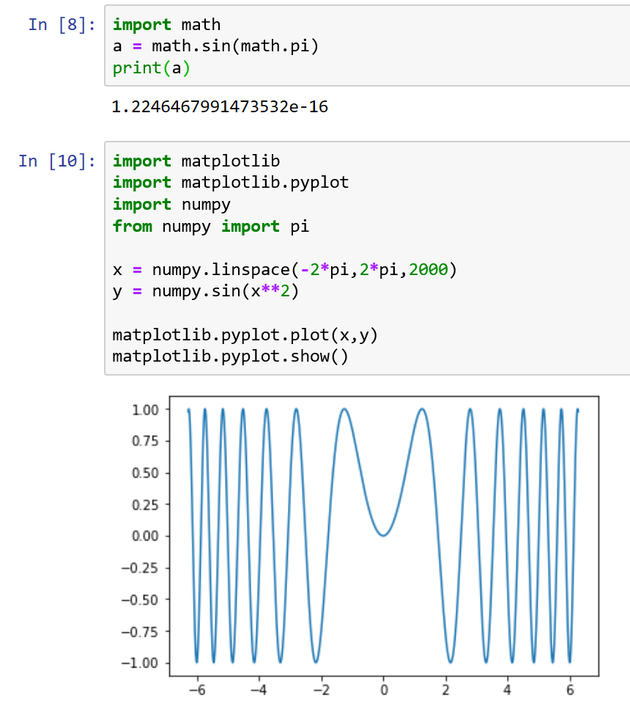
Using Modules
Modules are collections of related functions stored in one file
Module Objects are the namespaces under which functions stored in a module are accessed
A module is imported with the import keyword
Functions within a module are accessed using dot notation (ex. math.sin(value))

Slide 8
Using Modules
Module
Objects
Modules are collections of related functions stored in one file
Module Objects are the namespaces under which functions stored in a module are accessed
A module is imported with the import keyword
Functions within a module are accessed using dot notation (ex. math.sin(value))

Slide 9
Using Modules
Side note:
when is zero not zero?
sine(π) = 0, right?
Modules are collections of related functions stored in one file
Module Objects are the namespaces under which functions stored in a module are accessed
A module is imported with the import keyword
Functions within a module are accessed using dot notation (ex. math.sin(value))

Slide 10
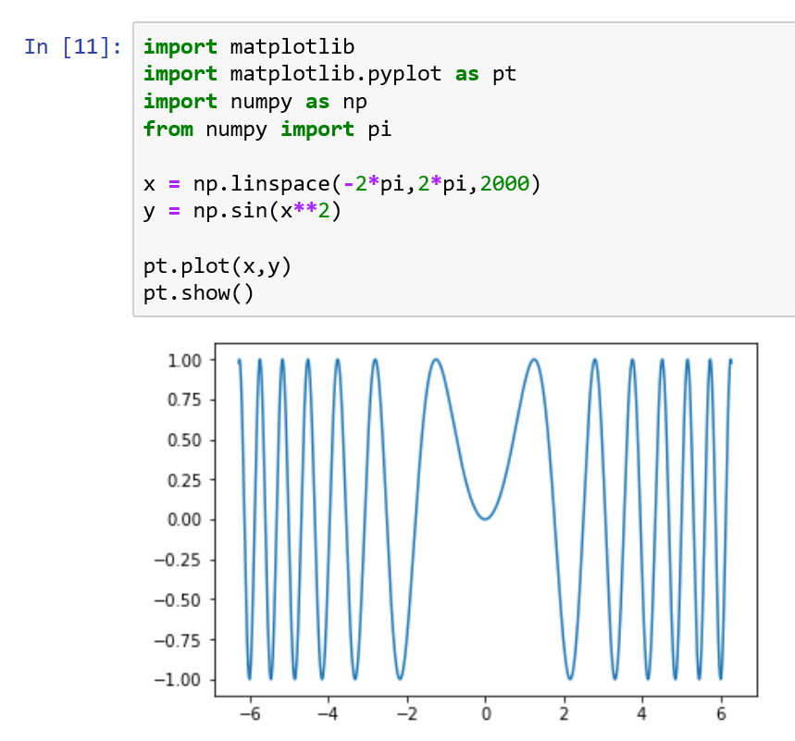
Aliases
Shortened names to refer to module objects
Declared using the as keyword

Slide 11
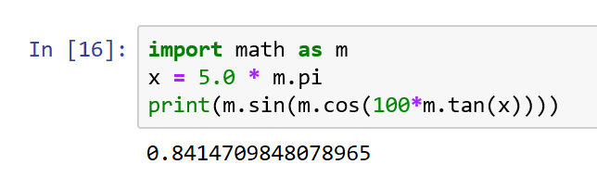
Composition
Using an expression as part of a larger statement
Anywhere a value can be used, a function which returns a value can be used in its place
In this example, a call to math.tan is a parameter for a call to math.cos which in turn is a parameter to math.sin, which is in turn a parameter to print.
  This works because tan returns a float, which is a valid parameter value for cos, which in turn returns a float, which is a valid parameter value for sin, etc.

Slide 12
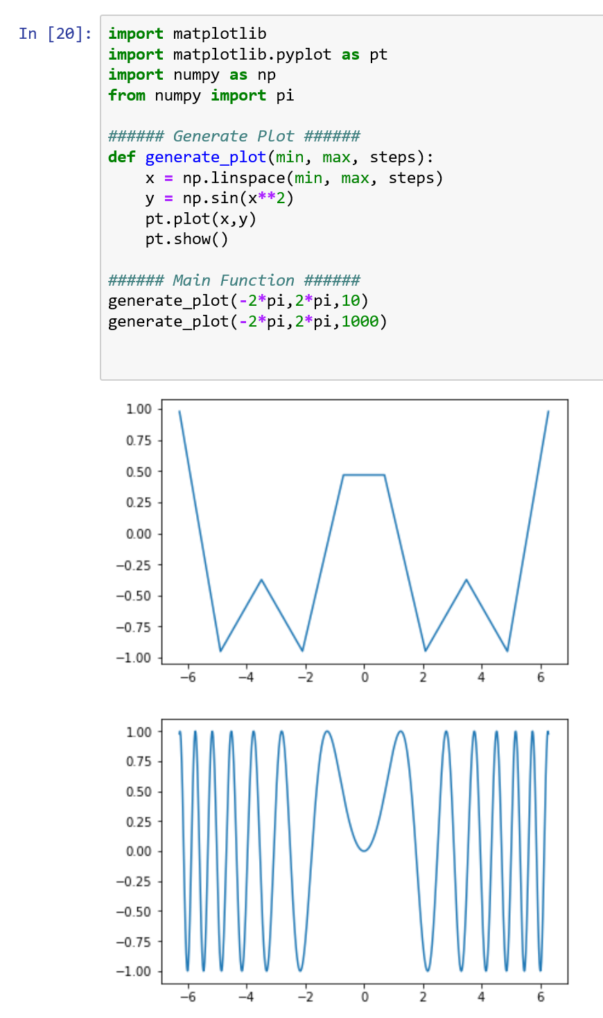
Defining Simple Functions
A function is defined with the def keyword
Functions have two parts, a header and a body
The header gives the function a name and defines allowed parameters
  The header is the first line
The body contains the statements which define the functions action
  Note how the body is indented
Together, the header and body is the function definition

Slide 13
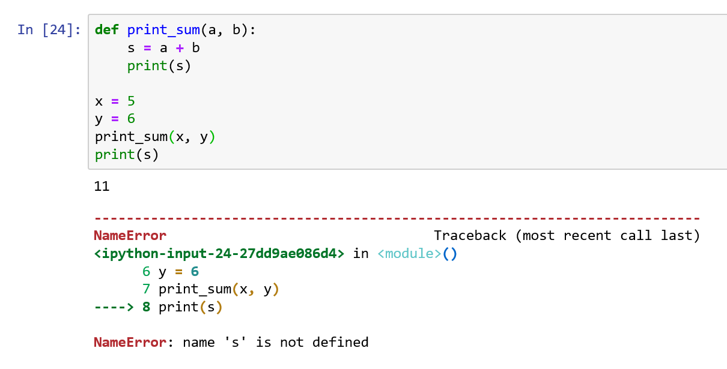
Variable Scope
Variables which are declared within a function or are in the parameter list can only be used within that function
  These variables are said to be local to that function
  Variables declared in the main function cannot be used in a function
  Where a variable is valid, is the scope of the variable
s is local to print_sum,
it can be used here
not here
Note the error

Slide 14
Variable Scope
Variables which are declared within a function or are in the parameter list can only be used within that function
  These variables are said to be local to that function
  Variables declared in the main function cannot be used in a function
  Where a variable is valid, is the scope of the variable
Parameters are copied in order
Note the error

Slide 15
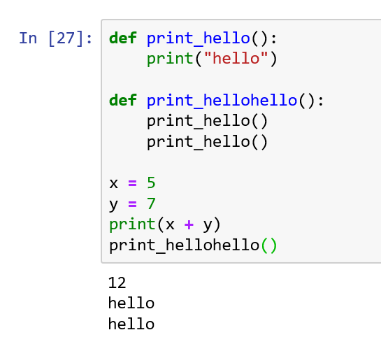
More Details
print_hello
definition
Functions must be defined before they can be used
Locally defined functions can be used within other locally defined functions
The main function is the entry point to the program
The main function has no header and is not indented
The main function follows all function definitions
print_hellohello
definition
main function
definition

Slide 16
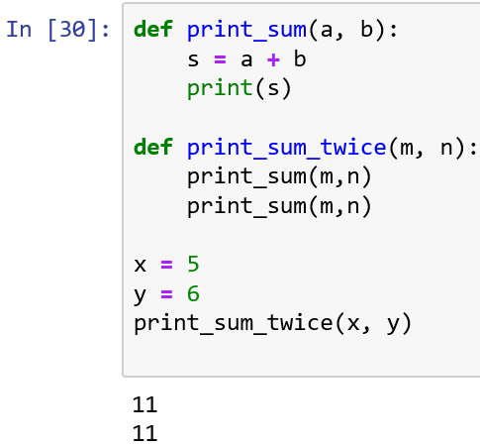
Stack Diagrams
A diagram showing the functions of a program and the variables and values which exist within each function in the order they are called
x -> 5
y -> 7
__main__
m -> 5
n -> 7
print_sum_twice
a -> 5
b -> 7
s -> 12
print_sum

Slide 17
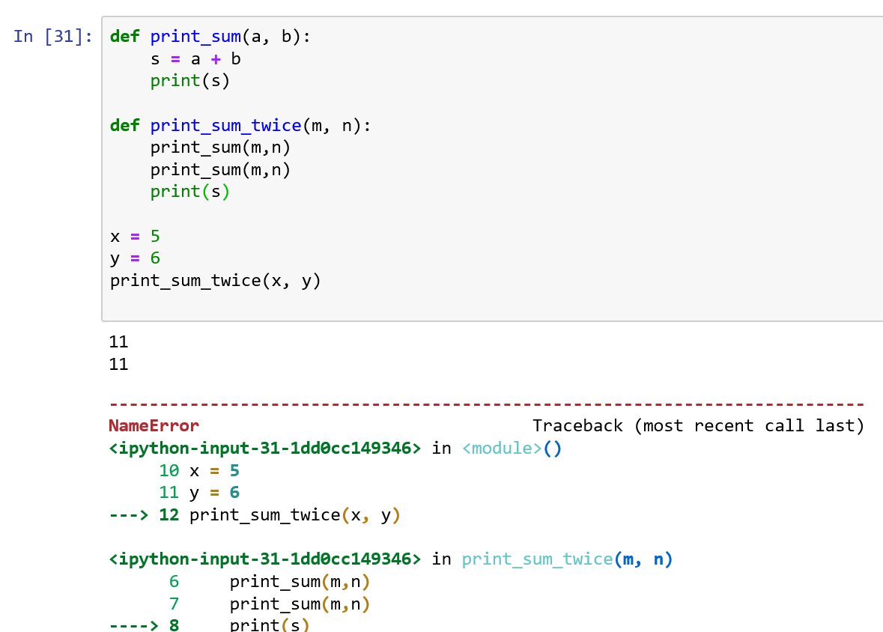
Stack Diagrams
When there is a run-time error in Python, the interpreter will generate a Traceback
This Traceback follows the same order as a stack diagram

Slide 18
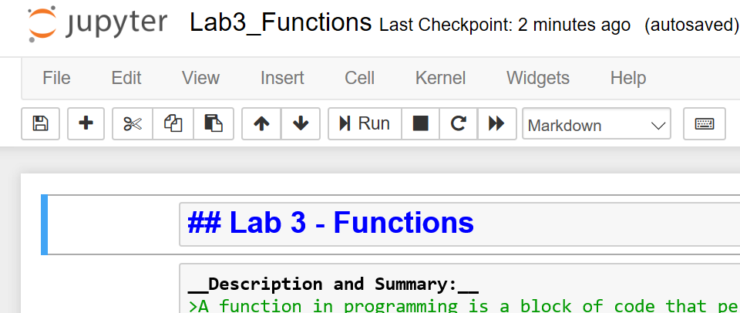
Jupyter Markdown
Markdown is a simple language for formatting text within a Jupyter notebook
To use Markdown, the cell must be set to Markdown
Various symbols change the way the text is displayed
Symbol | Function | Location
# | Creates a headline | At beginning of line
## | Creates a subheadline | At the beginning of line
> | Indents for attribution (blockquote) | At the beginning of paragraph
*** | Creates a horizontal rule | Alone on a line
_ | Light Emphasis | Around a word _italics_
__ | Strong Emphasis | Around a word __bold__
https://sourceforge.net/p/jupiter/wiki/markdown_syntax/

