Slide 1
Lecture 2
Python Programming & Data Types
Bryan Burlingame
6 February 2019

Slide 2
Announcements
All Material Posted to me30.org
Homework 1 due next week
Posted on me30.org
Read chapter 3 for next week

Slide 3
Running Python
Python is an interpreted language
  A language in which the instructions are executed by an “interpreter” at run time
As an interpreted language, Python is relatively easy to port to many environments to be used by various interpreters
  Command line
    Via the Python interpreter
  Script files
    Text files containing Python commands
  Jupyter Notebooks
    Used in this course
  Game scripting
    Blender, Panda3D, Kivy

Slide 4
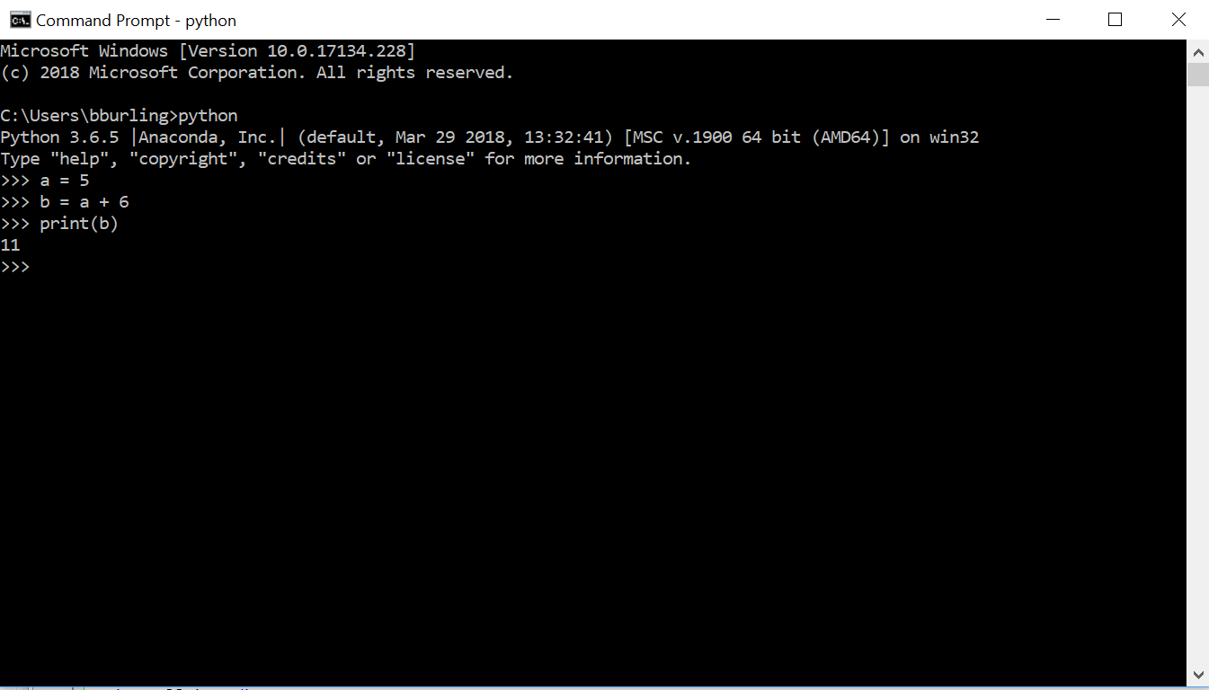
Interpreter command line

Slide 5
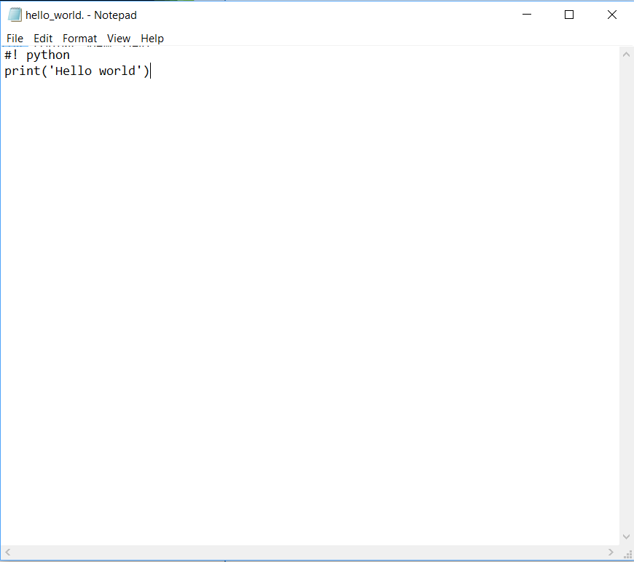
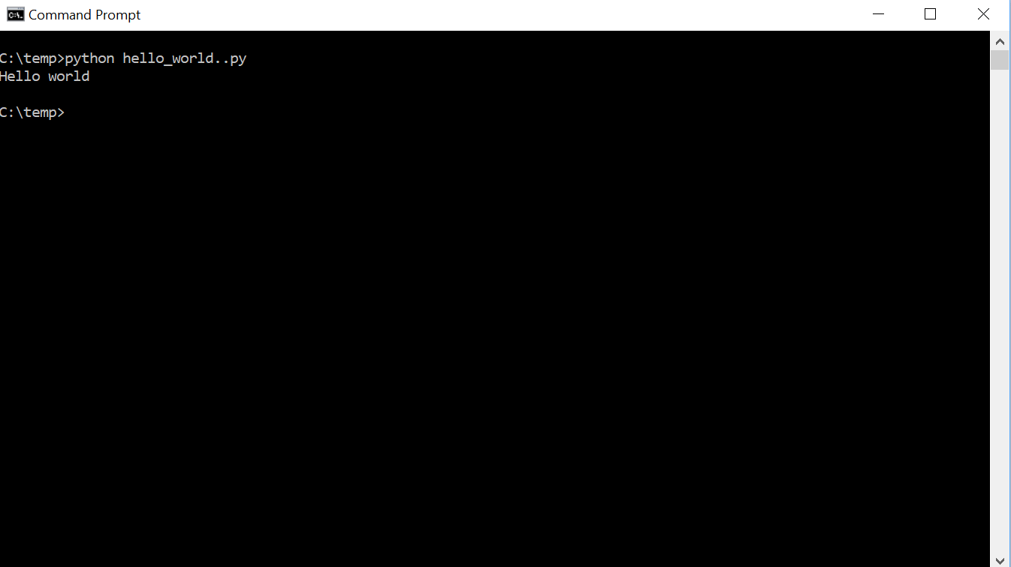
Script file

Slide 6
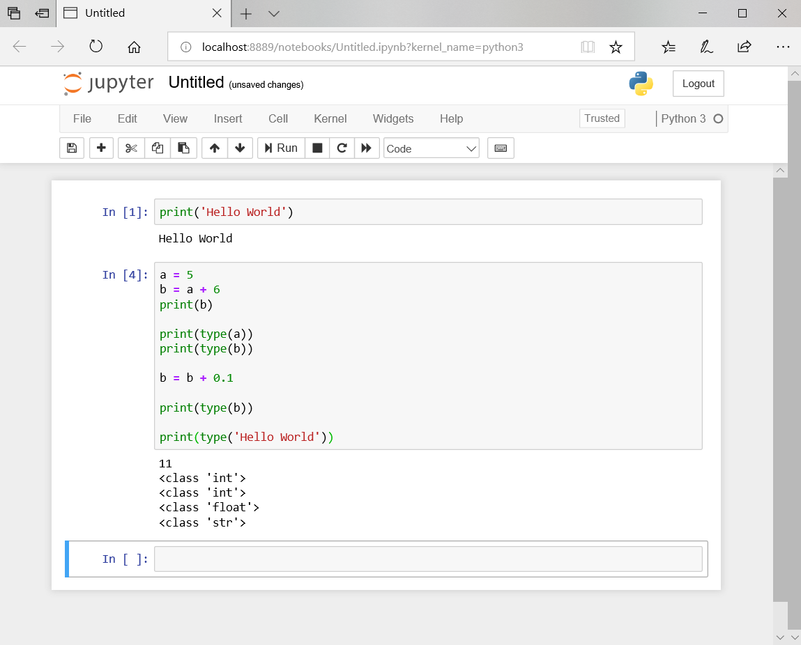
Jupyter Notebook

Slide 7
Python
The Python language itself is fairly simple, comprised of only 33 keywords
False | class | finally | is | Return
None | continue | for | lamda | try
True | def | from | nonlocal | while
and | del | global | not | with
as | elif | if | or | yield
assert | else | import | pass
break | except | in | raise
The power comes from the large number of built-in functions and the wealth of available libraries

Slide 8
Numeric
Values
Recall: the purpose of a computer is to compute some value based on some input
Python supports several numeric data types
  Integers in four bases
    Base 10 (decimal): 432
    Base 2 (binary): 0b110110000
    Base 8 (octal): 0o660
    Base 16 (hexadecimal): 0x1B0
    Range is limited only by hardware
  Floating point numbers
    Can be expressed as decimal floating point: 432.5
    Or Scientific Notation: 4.325e2
      e stands for exponent, 4.325e2 is the same as 4.325 X 10²
    Range is about (-1.8e308 – 1.8e308)
      Higher than 1.79e308 is inf.
      Lower than -1.79e308 is -inf
  Complex numbers
    (real)+(imaginary)j, i.e. 4+32.5j

Slide 9
String Values
Strings are sequences of characters
String literals are bounded by either single quotes ‘ or double quotes “
  “Hello World” and ‘Hello World’ are equivalent
  Number in quotes are treated as strings, not numbers
    ‘42.0’ does not equal 42.0

Slide 10
Boolean Values
True or False

Slide 11
Operators
Sr.No | Operator & Description
1 | ** Exponentiation (raise to the power)
2 | ~ + - Complement, unary plus and minus
3 | * / % // Multiply, divide, modulo and floor division
4 | + - Addition and subtraction
5 | >> << Right and left bitwise shift
6 | & Bitwise 'AND'
7 | ^ | Bitwise exclusive `OR' and regular `OR'
8 | <= < > >= Comparison operators
9 | <> == != Equality operators
10 | = %= /= //= -= += *= **= Assignment operators
11 | is is not Identity operators
12 | in not in Membership operators
13 | not or and Logical operators
Python can act as a simple calculator and support many operators

Slide 12
Using Operators
Based on arithmetic, though with more operators. Follows the precedence table
Parenthesis overrides precedence
  What’s the difference between 4 + 5 * 3 and (4 + 5) * 3?
Note! Exponentiation ** has higher precedence than unary –
  What does -1**2 equal?
Operands
4 + 5
Operator

Slide 13
String Operators
+ Concatenation
“Hot” + “dog” is “Hotdog”
* Replication
“Clap” * 3 is “ClapClapClap”

Slide 14
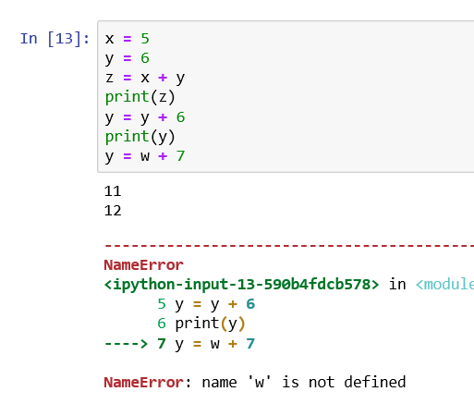
Variables
A variable is a name which refers to a value. That value can vary over time.
artemis = 5
  Create an integer with value 5 and then associates the name artemis to it
pi = 3.14159
  Create a float with value 3.14159 and then associate the name pi to it
Before a variable can be used, it must be assigned a value

Slide 15
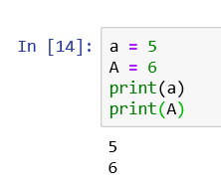
Variable names
Letters, numbers, and underscore _
Python is case sensitive
  a and A are different values
Cannot start with a number
  season5 is valid, 5season is not
Cannot be one of the Python reserved words
  lamda is not a valid variable name
Make variable names meaningful
  Storing the area of a triangle
    x is terrible, what does it have to do with area or a triangle
    a is ok, but not descriptive
    area is better, area_of_a_triangle is valid but probably too long
    t_area or triArea may be better depending on the context

Slide 16
Assignments
x = 4 * 7 + a * 2
Left Hand Value (LHV)
The name the value will be stored under
Right Hand Value (RHV)
The value being generated
Assignment Operator
Defines how will the value be stored

Slide 17
Assignments
x = 4 * 7 + a * 2
Left Hand Value (LHV)
The name the value will be stored under
Right Hand Value (RHV)
The value being generated
Operator | Action
= | Simple Assignment
+= | Add RHV to LHV
-= | Subtract RHV from LHV
*= | Multiply RHV to LHV
/= | Divide LHV by RHV
… | Etc.
Assignment Operator
Defines how will the value be stored

Slide 18
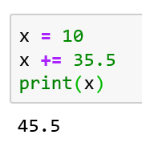
Assignments
x = 4 * 7 + a * 2
Left Hand Value (LHV)
The name the value will be stored under
Right Hand Value (RHV)
The value being generated
Operator | Action
= | Simple Assignment
+= | Add RHV to LHV
-= | Subtract RHV from LHV
*= | Multiply RHV to LHV
/= | Divide LHV by RHV
… | Etc.
Assignment Operator
Defines how will the value be stored

Slide 19
Variable Type
Unlike C, C++, or many other languages, Python is dynamically typed
If a variable comes into existence by assigning it a value, how does Python know what data type it is?

Slide 20
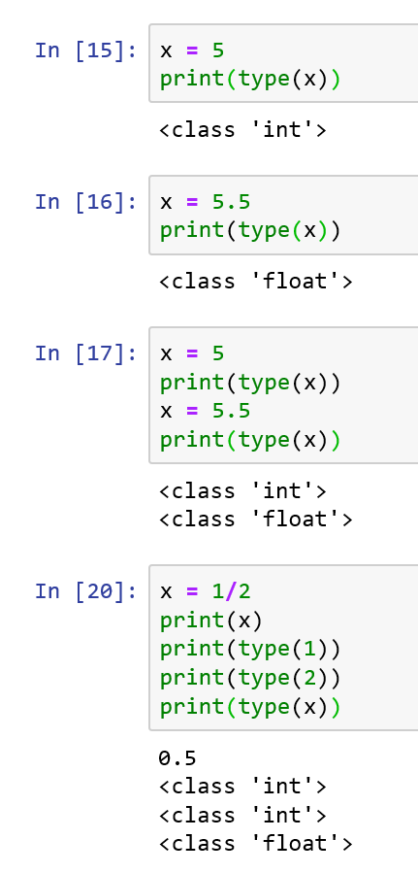
Variable Type
Unlike C, C++, or other languages, Python is dynamically typed
If a variable comes into existence by assigning it a value, how does Python know what data type it is?
  It infers the type from the assignment

Slide 21
Variable Type
Unlike C, C++, or other languages, Python is dynamically typed
If a variable comes into existence by assigning it a value, how does Python know what data type it is?
  It infers the type from the assignment
  integers are preferred over floats

Slide 22
Variable Type
Unlike C, C++, or other languages, Python is dynamically typed
If a variable comes into existence by assigning it a value, how does Python know what data type it is?
  It infers the type from the assignment
  integers are preferred over floats
  the type of a variable dynamically changes based on need

Slide 23
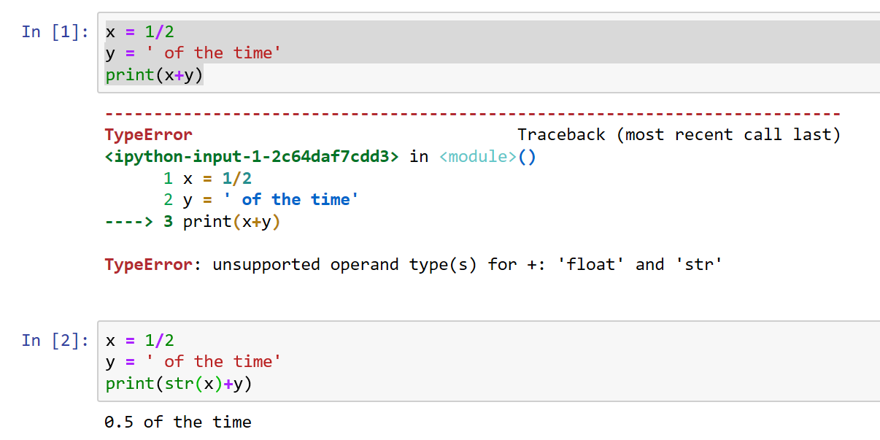
Converting to Strings
Use the str(value) function to convert a number to a string
  str – string representation

Slide 24
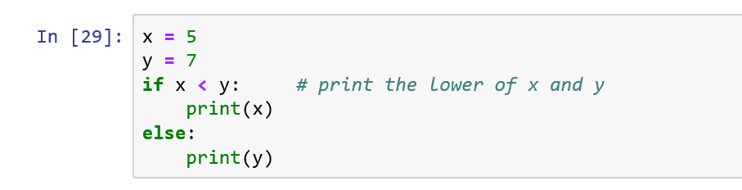
Comments
Text put into a program to assist the programmer
All text which follows a # is ignored by Python

Slide 25
Bugs
Bug
  An error in a program
Types of bugs
  Syntax errors
    Problems with the syntax of the source code which stops the parser from being able to understand the program
  Run-time errors
    Errors which occur while the program is running.
  Semantic (Logic) errors
    Programs which parse and run fine, but do not do what is intended
Debugging
  The process of removing bugs

Slide 26
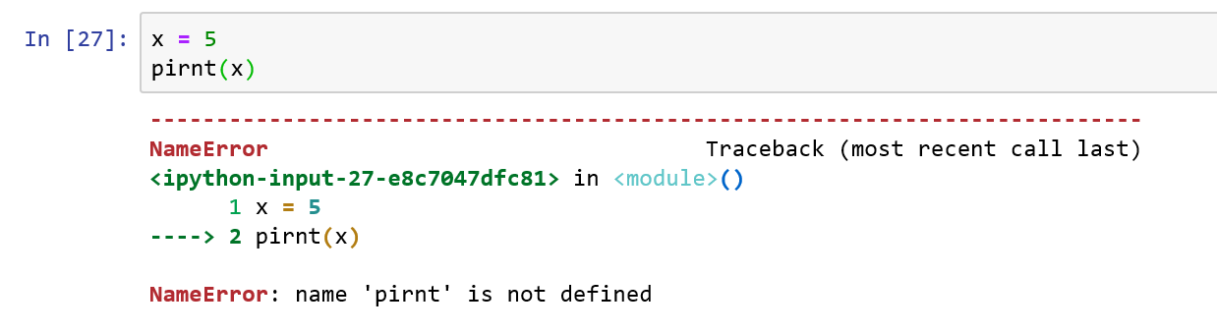
Syntax Error
An error in the grammar of the program

Slide 27
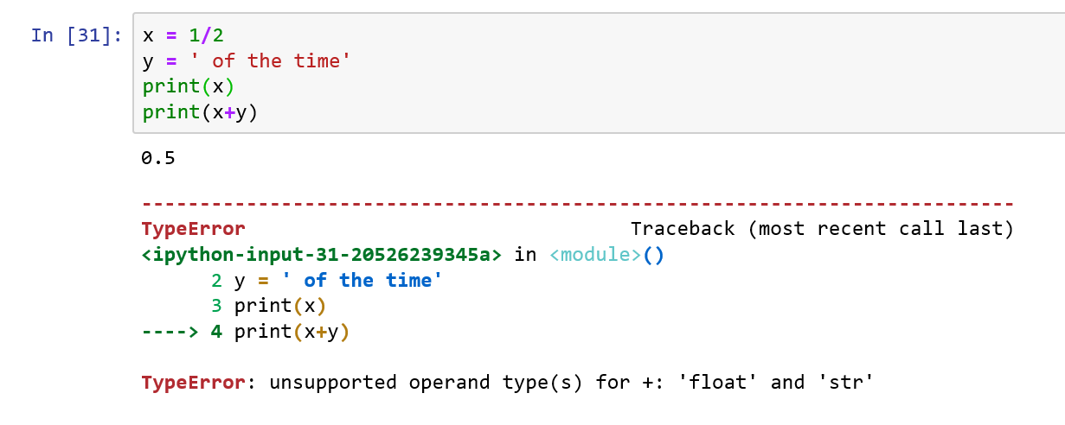
Run-time Error
An error which occurs while the program is running which the stops the operation of the Python interpreter

Slide 28
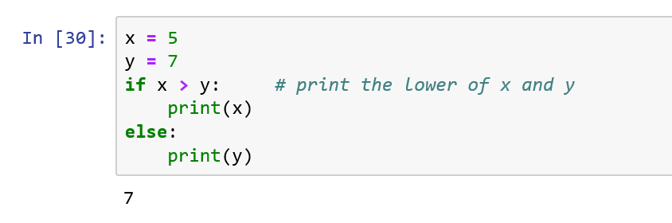
Semantic (Logic) Error
An error in the logic of a program, causing the program to generate a result different than expected

Slide 29
Semantic (Logic) Error
An error in the logic of a program, causing the program to generate a result different than expected
Note how Python helps find the source of Syntax and Run-time errors, but not Logic errors

Slide 30
Resources
Downey, A. (2016) Think Python, Second Edition Sebastopol, CA: O’Reilly Media

