Slide 1
Lecture 1: Course Introduction
B Burlingame
29 January 2019

Slide 2
The Plan for Today
Welcome to ME 30
Introduce me
Learning objectives
Highlights from the syllabus (aka, ‘greensheet’)
Motivation for the course
  Computers & Embedded Systems
  Development process
  Creating Software
    Python
    A Python program
    Jupyter Notebooks
  Bugs

Slide 3
My Background
Industry experience
  Microsoft Corporation – Director of Silicon Infrastructure
    Dishplayer (1999)
    UltimateTV (2000)
    Xbox (2001)
    Xbox 360 (2005)
    Kinect (2010)
    Xbox One, Kinect II, Xbox One S (2013)
    Surface Book (2015)
    Xbox One S (2016)
    HoloLens (2016)
    Project Scorpio Xbox One X (2017)
California Native
  Grew up in Manteca, CA (one of those places where they still grow food)
Personal
  Hobbies: build things, fix things, cycling, scuba diving, reading literature
Why Engineering?
  Engineering is the highest form of creation open to man. We get to harness the possibilities crafted by science to creatively enhance life’s experience
Why am I in this class in the middle of a work day?
  To help foster as many awesome engineers as possible
  The more brains we have to create a more interesting world, the more interesting the world shall become

Slide 4
Learning Objectives
Solving problems with computers
  Learn the process for formulating a computational solution to a problem
  Practice the process
  Develop debugging techniques
Gain familiarity with software and systems used for technical computing
  Development environments
  Embedded systems
  Data analysis
Learn structured programming using the Python language
  Get prepared for mechatronics

Slide 5
Where to Find Things
Syllabus available at
  http://me30.org
  spring2019@me30.org
  Office Hours: TBA
Course information
  Course goals and learning objectives
  Textbook (both are linked to on me30.org)
    Think Python - How to Think Like a Computer Scientist 2nd Edition by Allen B. Downey (978-1-491-93936-9)
      Printed copies available from Amazon ($29.83)
    Automate the Boring Stuff with Python: Practical Programming for Total Beginners by Al Sweigart (978-1-59327-599-0)
      Printed copies available from Amazon ($24.92)
  Policies and protocol
  Grading
  Resources
  Course schedule

Slide 6
Announcements
For next week
  Read chapters 1 & 2
  Install Anaconda
    http://www.anaconda.com
Labs start today
  For the purpose of this class, the week starts on Wednesday
  Bring your laptop to Lab

Slide 7
Highlights from the Syllabus
Grades
  No late work accepted
  All labs and homework have equal weight
    Lowest two will be dropped
    Homework + Labs comprise 50% of the final grade
  Two evaluations
    One around the midpoint of the term and one during finals week
    A problem will be assigned and you’ll present the solution to me
    The two evaluations comprise the other 50% of the final grade
  Extra credit
    In class, in lab, and in homework extra credit opportunities will be offered
  No late work accepted
Labs start next week
  We’ll start with Python
  Lab are written for Jupyter Notebooks using Python
    Open Lab in Eng 213
Lab kits will be available around week 8
  Arduino + Spartan Experimenter
No late work accepted
No late work accepted
No late work accepted
No late work accepted

Slide 8
    Highlights from the Syllabus
    Grades
  No late work accepted
  All labs and homework have equal weight
    Lowest two will be dropped
    Homework + Labs comprise 50% of the final grade
    Two evaluations
    One around the midpoint of the term and one during finals week
    A problem will be assigned and you’ll present the solution to me
    The two evaluations comprise the other 50% of the final grade
    Extra credit
    In class, in lab, and in homework extra credit opportunities will be offered
  No late work accepted
    Labs start next week
    We’ll start with Python
    Lab are written for Jupyter Notebooks using Python
    Open Lab in Eng 213
    Lab kits will be available around week 8
    Arduino + Spartan Experimenter
No late work accepted
No late work accepted
No late work accepted
No late work accepted

Slide 9
Meet someone
Take two minutes to meet someone in class you do not know

Slide 10
Computer and Embedded Systems
What is a computer?
  A machine which:
    Reads input
    Runs some computations
    Generates output
    Repeat
  Each of these steps is controllable via a “Program”
What is an embedded system?
  A computer embedded into a larger system
What is a program?
  An ordered set of instructions defining the function of a computer
  Computers understand “Machine Language”
    A series of instructions rendered in zeros and ones, ons and offs which activate the physical hardware for each instruction
    Machine language is viscously difficult for us humans

Slide 11
Development Process
Solution:
  High level programming language such as Python
Programming language
  A formal language which has been designed to express computations
  Follows strict rules of grammar with singular meaning

Slide 12
Python
2007, 2010 Language of the year by TIOBE
4th most popular language (and climbing)
  Java, C, & C++ are ahead (though both Java and C++ are in decline)
What is Python and why are we learning it?
  Fast development: Python is an interpreted language, the edit-test-debug cycle is quick
  Easy to code: Python is a relatively new language, the syntax is clear and fairly easy to read
  Modular: There are thousands of packages targeted at scientific and engineering computing which are easy to install and easy to use
  Popular: Python is widely used in industry for systems automation and data analysis
Frequently, the most expensive part of an engineering project is an engineer’s time. Python minimizes those tasks which cost engineering time.

Slide 13
Python
If Python is so great, why do other languages even exist (i.e. what are Python’s weaknesses)?
  Computationally slow: By being easy to program, the Python interpreter must do a lot of work to execute each command
  Memory inefficient: See above
  Very high level: Since so much is being done for the programmer, the programmer cannot control many aspects of how the program runs. Further, the programmer cannot directly interface with hardware unless some module exist allowing such interaction
When computational efficiency outweighs programmer time, a different language is usually used.

Slide 14
Hello World
print (‘Hello World’)

Slide 15
Running Python
As an interpreted language, Python is fairly easy to port to many environments
  Interpreter command line
  Script files
  Jupyter Notebooks

Slide 16
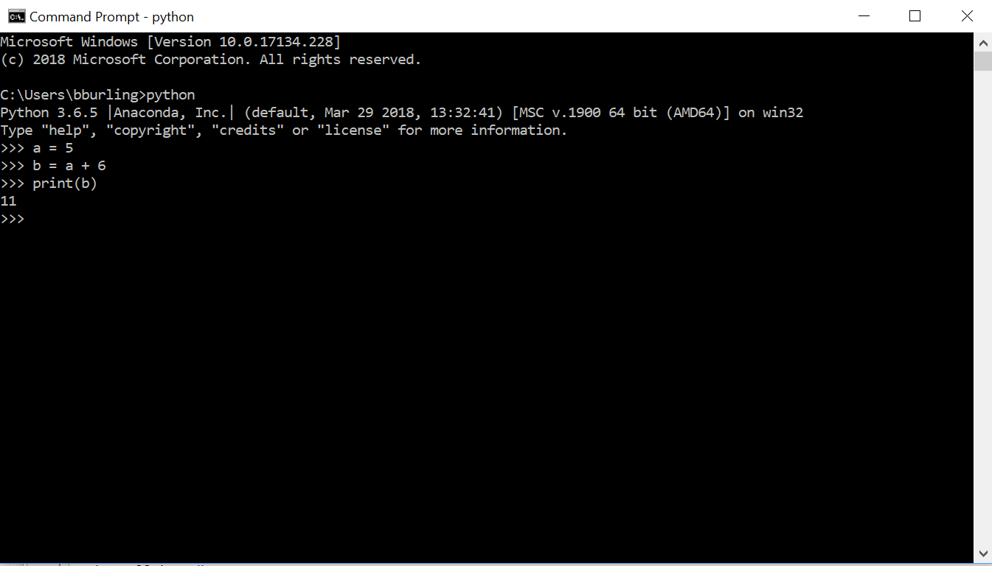
Interpreter command line

Slide 17
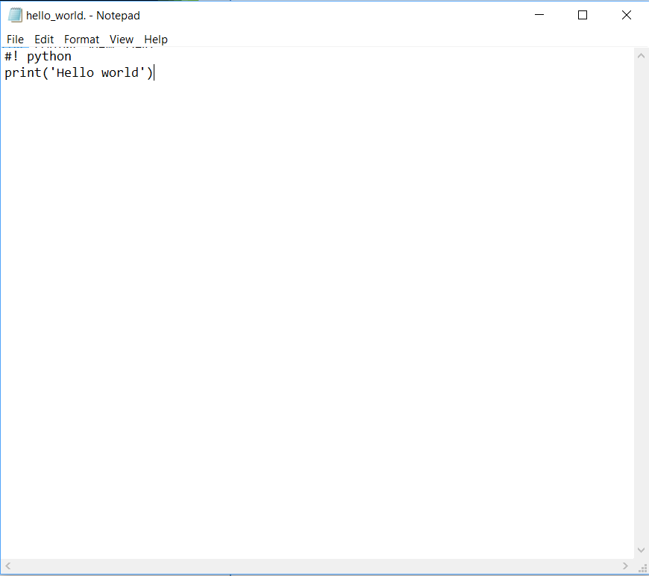
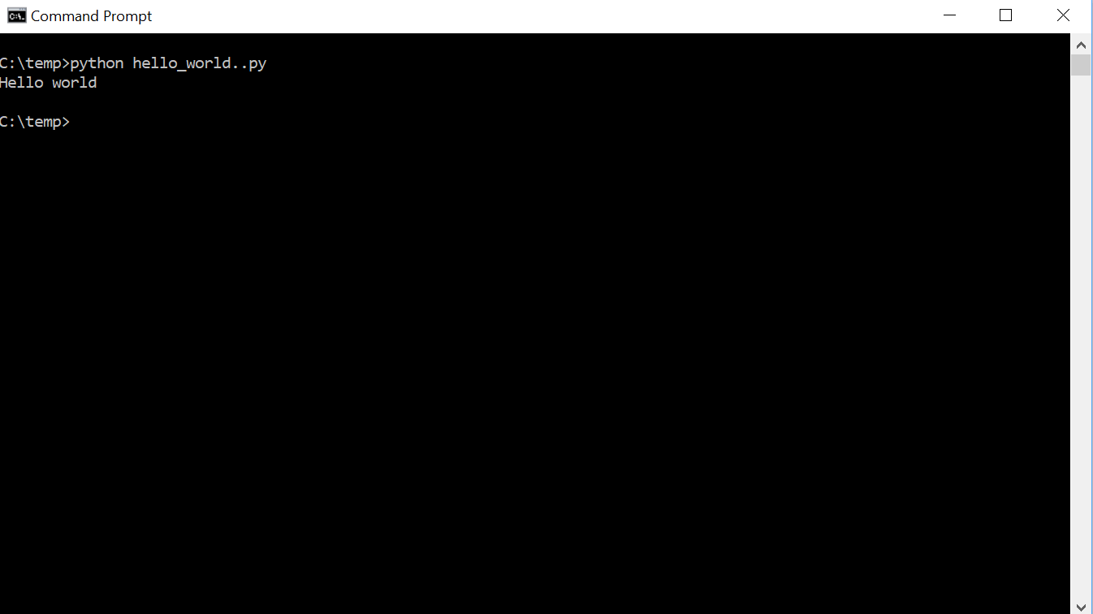
Script file

Slide 18
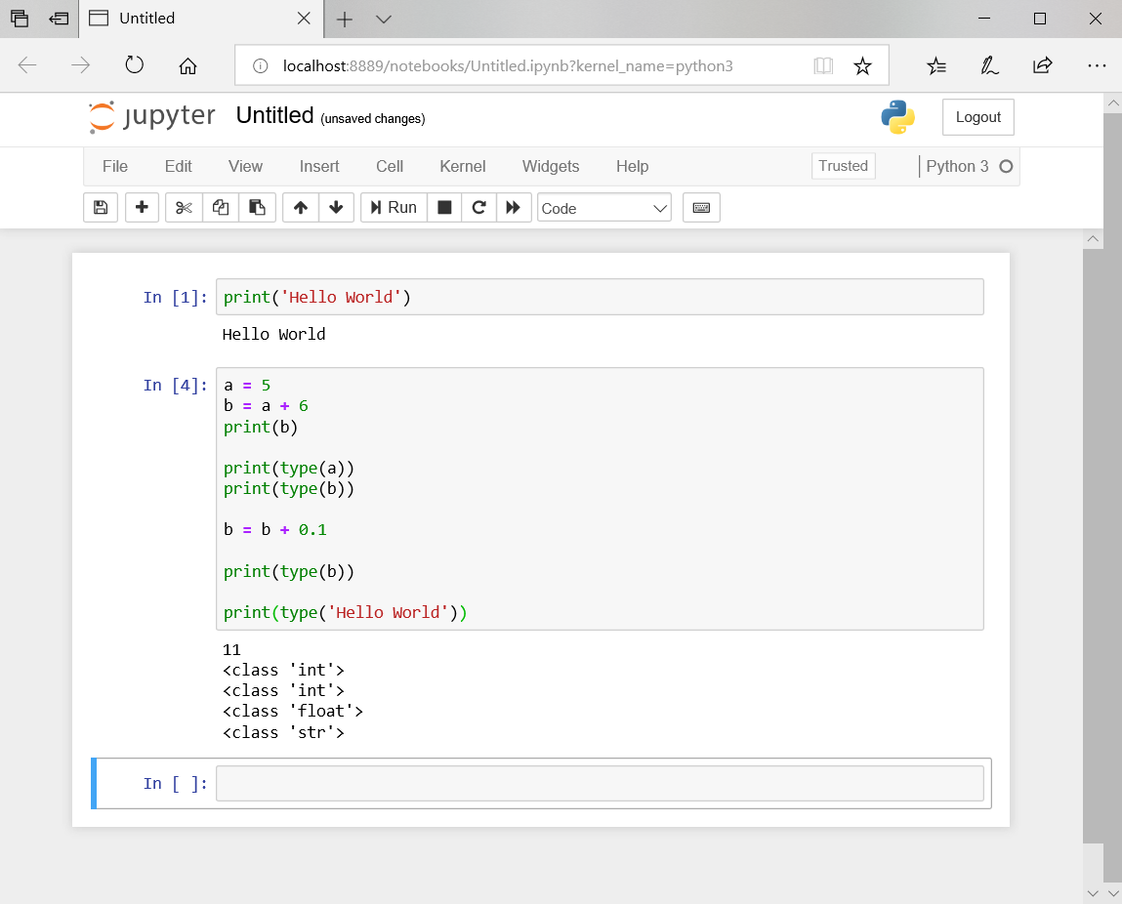
Jupyter Notebook

Slide 19
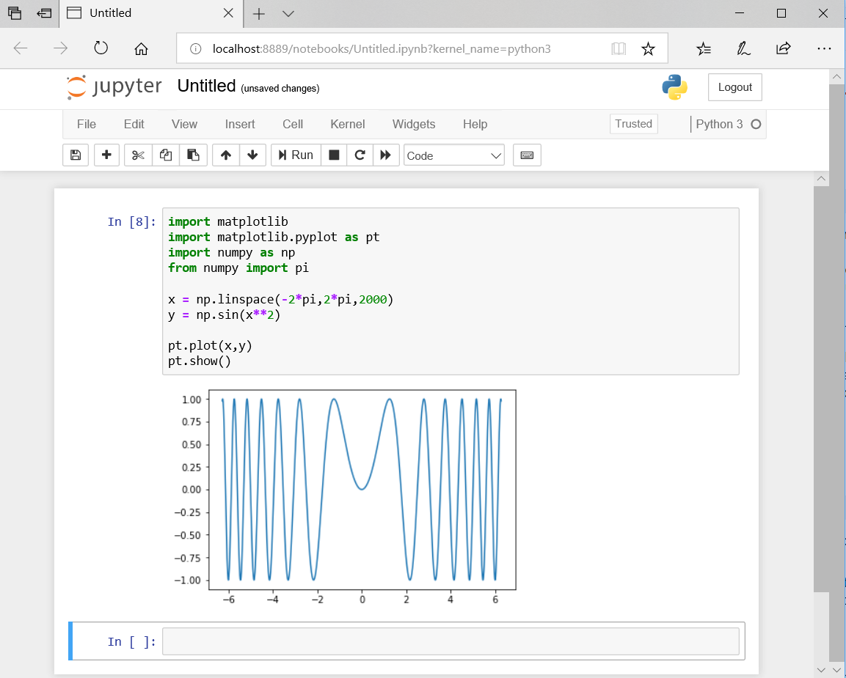
Jupyter Notebook

Slide 20
Bugs
Bug
  An error in a program
Types of bugs
  Compile-time bugs
    Problems with the syntax of the source code which stops the compiler from being able to compile the program
  Run-time bugs
    Errors which occur while the program is running.
  Logic bugs
    Programs which compile and run fine, but do not do what is intended
Debugging
  The process of removing bugs

Slide 21
Sources
King, K. N. (1996) C Programming: A Modern Approach. New York, NY: W.W. Norton & Company Ltd.
Downy, A.B., Scheffler, T. (2018) How to Think Like a Computer Programmer – C Version. From personal correspondence with Mr. Scheffler. Publically available at http://me30.org

